Slide 1
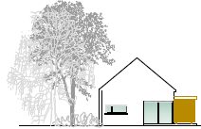
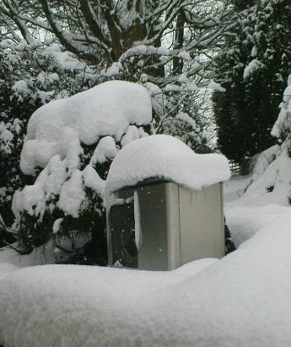
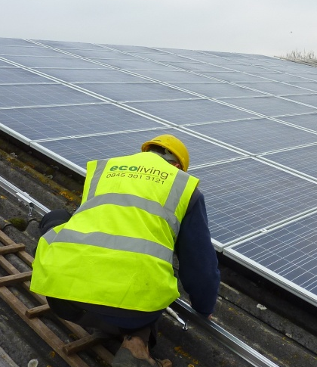

www.ecolivinguk.com
Energy Efficiency:
“Micro-renewable energy solutions
for affordable housing in
sustainable communities”
© Ecoliving Ltd
Frank McElroy, Regional Director, Ecoliving
micro-renewable solutions for a sustainable future

Slide 2

www.ecolivinguk.com
Micro-renewables in Affordable Housing
Ecoliving has a strong track record of delivering appropriate micro-renewable solutions for affordable housing.
Systems are designed to meet specific and agreed objectives:
Minimising tenants’ energy bills
Fighting fuel poverty
Mitigating the effects of rising energy prices
Reducing CO2 emissions
Compliance with UK and EU legislation
  Code for Sustainable Homes etc.
Improving indoor climate and comfort levels
Upgrading heating systems - Decent Homes etc.
© Ecoliving Ltd
micro-renewable solutions for a sustainable future

Slide 3
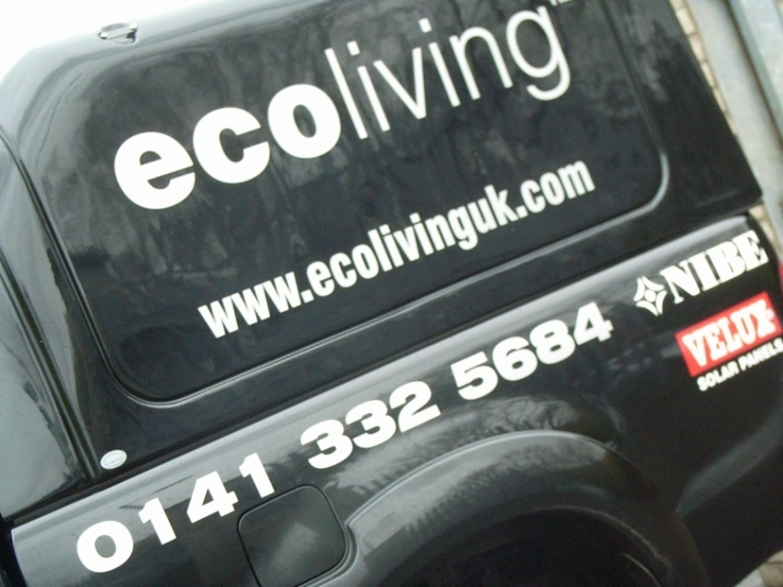
www.ecolivinguk.com
Agenda
Introduction
The Bigger Picture
Our Approach
Ecoliving USP’s
Track Record
Micro-renewable Energy Solutions
Case Studies
Ecoliving Partnering Methodology
© Ecoliving Ltd
micro-renewable solutions for a sustainable future

Slide 4
www.ecolivinguk.com
Introduction to Ecoliving
Ecoliving - established in 2004
Specialist, technical micro-renewable energy solutions provider
Introducing best practice from developed Scandinavian low carbon economies
Developing and supporting network of approved installers through hundreds of installations UK wide
Pioneering and accelerating the adoption of micro-renewable energy:
- affordable housing: new development & heating upgrades
- programme of CPD seminars to architects and consultants
Responsible marketing through seminars, events, exhibitions and PR
Project management of installation, commissioning and system handover
After sales support, maintenance and ‘Health Checks’
© Ecoliving Ltd
micro-renewable solutions for a sustainable future

Slide 5

The Bigger Picture
If all 6.75 billion people on the planet lived like we do in the West, 3 planet Earths would be required to sustain us.

Slide 6


The Bigger Picture
The current situation is unsustainable!
Urgent action is needed!
© Ecoliving Ltd

Slide 7

www.ecolivinguk.com
UK CO2 Emissions
Buildings are responsible for almost 50% of the UK's energy consumption and carbon emissions
2007 - total UK CO2 emissions - 543 million tonnes
26% (142 million tonnes) from energy we use to heat, light and power our homes
Micro-renewable energy (on-site) solutions are a key tool in the mix of measures that reduce CO2 emissions from new and existing homes
© Ecoliving Ltd
micro-renewable solutions for a sustainable future

Slide 8

At Ecoliving, we feel passionate about being part of the solution and making a difference.
We believe we have a meaningful contribution
to make!
© Ecoliving Ltd

Slide 9
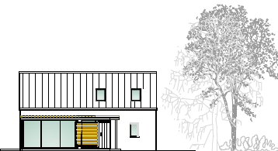
www.ecolivinguk.com
The Ecoliving Approach
Survey & analysis of:
The Development / Dwelling Client Needs Site Characteristics
Review the
options
Appropriate solutions
Critical Success Factors:
Appropriate Design
Quality Products
Experienced Installer
© Ecoliving Ltd
micro-renewable solutions for a sustainable future

Slide 10
www.ecolivinguk.com
Renewable Energy
The main sources of renewable energy and how they can be used.
Micro-renewable energy systems delivered by Ecoliving.
Source Utilisation Output
Sunlight - heat Solar water heating Hot water
Biomass - wood Combustion – boiler or stove Heat
Sunlight – heat from sun
transferred to soil, air or
water Ground source heat pump
Air source heat pump
Water source heat pump
Passive solar Heat and hot water
Sunlight - photons Solar photovoltaic cells (PV) Electricity
Wind Wind turbine Electricity
Water Hydro turbine Electricity
Biomass - wood Combustion: boiler + steam turbine Heat and electricity
Biomass – biodegradable matter Anaerobic digestion (
decomposition without oxygen to
produce methane) to burn in a
combustion engine or CHP system Heat and Electricity
Wave (wind) Floating or shore based electrical
generators converting kinetic energy from
waves. Electricity
© Ecoliving Ltd
micro-renewable solutions for a sustainable future

Slide 11


www.ecolivinguk.com
Ecoliving USPs
One-stop micro-renewables solutions provider
Survey & design through to system commissioning and maintenance
Broad range of technologies, integrated systems and solutions
‘Best in class’ products from pioneering manufacturers
Growing UK-wide national network of Ecoliving offices with qualified staff offering local service
MCS accredited installer and MCS accredited products
Web-enabled CRM and Technical Support Help Desk
Access to funding
© Ecoliving Ltd
micro-renewable solutions for a sustainable future

Slide 12

www.ecolivinguk.com
Ecoliving – Unique Track Record
Established 2004
In-depth design and technical knowledge
8 years of experience covering many hundreds of installations
Trained, experienced, customer focused and committed team
Responsive service and key account manager
Developing and supporting network of approved installers through hundreds of installations UK-wide
Pioneering the adoption of micro-renewable energy in affordable housing heating upgrades
  Scottish Government - Renewables Heating Pilot
  Extensive work with the Energy Saving Trust
  Extensive work with RSL’s on new development and heating upgrade projects
© Ecoliving Ltd
micro-renewable solutions for a sustainable future

Slide 13
www.ecolivinguk.com
Ecoliving – Unique Track Record
Ecoliving has worked with a wide range of RSL’s from Shetland to the Isle of Wight
Albyn Housing Trust
Cairn Housing Association
Castlehill Housing Association
Eildon Housing Association
Energy Saving Trust
Falkirk Council
Fife Council
Fyne Homes
Highland Council
Hjaitland Housing Association
Lochalsh & Skye Housing Association
One Vision Housing
Orkney Housing Association
Port Sunlight Village Trust
Servite Housing Association
South Ayrshire Council
South Staffordshire Housing Association
South Yorkshire Housing Association
© Ecoliving Ltd
micro-renewable solutions for a sustainable future

Slide 14
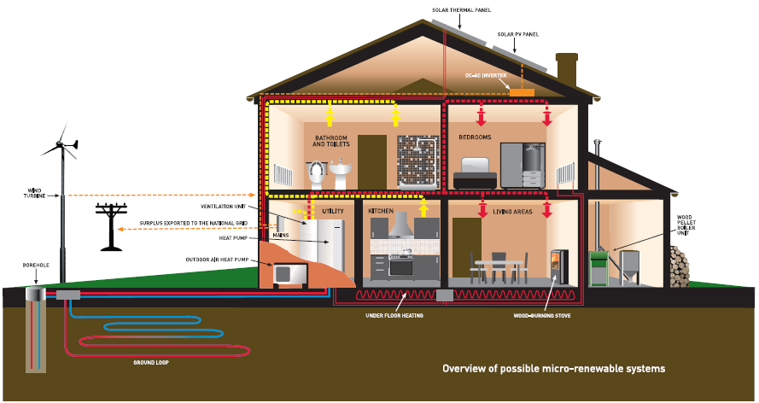
www.ecolivinguk.com
Micro-renewable Energy Solutions
Broad range of products to call on in designing solutions appropriate to client, dwelling and site requirements
SOLAR THERMAL PANEL
SOLAR PV PANEL
BIOMASS BOILER
WOOD-BURNING STOVES
UNDER FLOOR HEATING
HEAT RECOVERY VENTILATION
OUTDOOR AIR HEAT PUMP
GROUND SOURCE HEAT PUMP
BOREHOLE
GROUND LOOP
WIND
© Ecoliving Ltd
micro-renewable solutions for a sustainable future

Slide 15
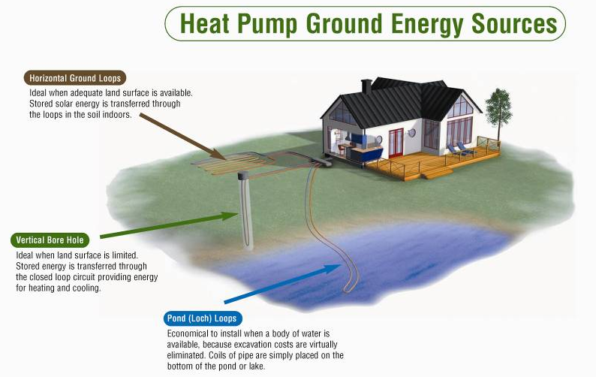
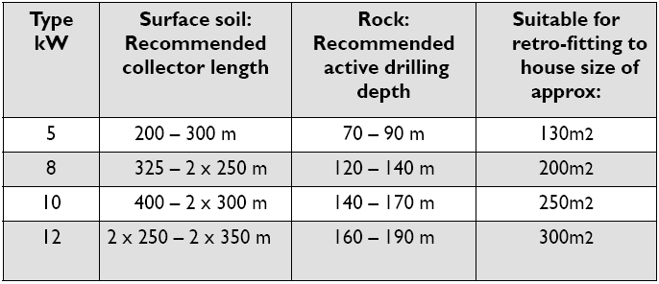
www.ecolivinguk.com
Ground Source Heat Pump
© Ecoliving Ltd
micro-renewable solutions for a sustainable future

Slide 16
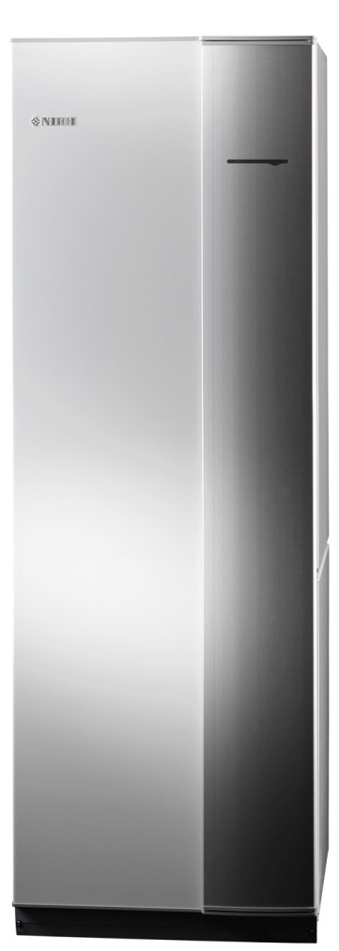
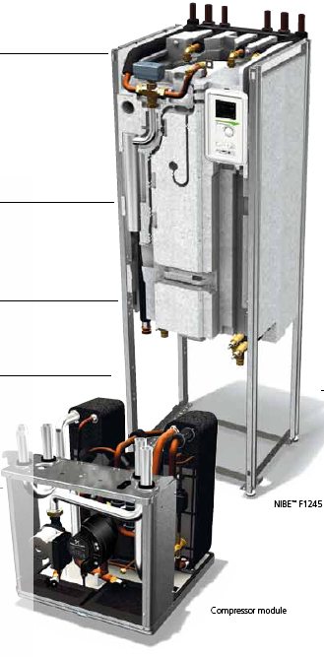
www.ecolivinguk.com
Ground Source Heat Pump
NIBE F1245
Heating and Hot Water
5kW, 8kW & 12kW single phase
Weather compensated heating system
maintaining a constant indoor
temperature 24/7
Complete heat pump unit with built-in
180 litre hot water cylinder
High level of efficiency offers energy
savings up to 75%
- Reducing carbon emissions
- Minimising heating bills
Soft start & well sound proofed
Complete heating system with
immersion back-up built in
© Ecoliving Ltd
micro-renewable solutions for a sustainable future

Slide 17
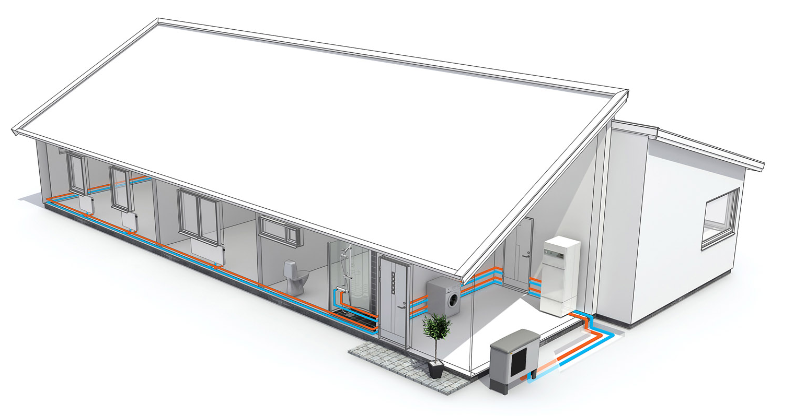
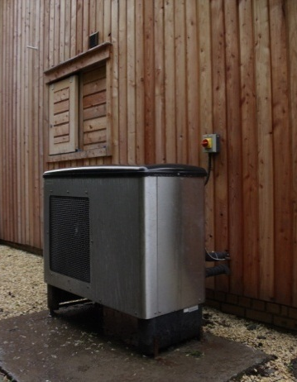
www.ecolivinguk.com
Outdoor Air Heat Pump
NIBE F2015
Heating and Hot Water
8kW & 11kW single phase
Outdoor air sucked in
over heat exchanger at the
back and heat is recovered
Operates to -20°C
Ideal where ground source difficult to install
Positioning of the unit is important – cold air & sound
Ideal for heating upgrades
Faster and less expensive installation
Efficiency slightly less than ground source
© Ecoliving Ltd
micro-renewable solutions for a sustainable future

Slide 18
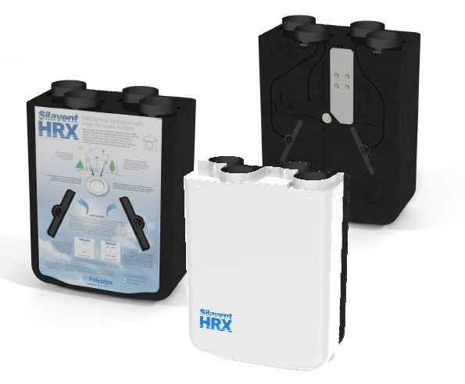
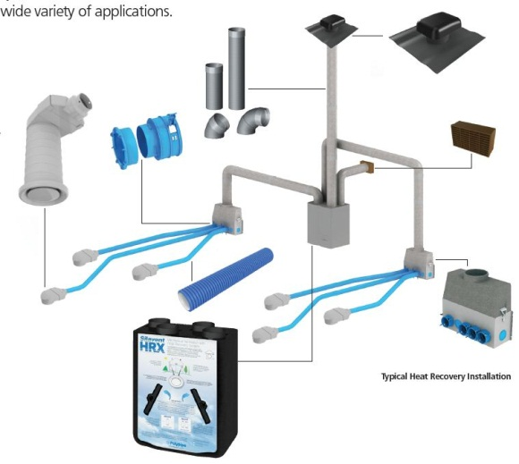
www.ecolivinguk.com
Heat Recovery Ventilation
Essential in modern New Homes
The heat exchanger delivers a healthy indoor climate.
It controls the ventilation with heat recovery reusing the heat energy from the extracted air. Not only that, additional heat gains from lighting, people, domestic appliances and solar energy is also recovered.
As stale, damp, air is extracted from the ‘wet’ rooms, fresh air is drawn into the unit, filtered and then warmed by the extracted air before being distributed to the living rooms.
Once the heat energy has been extracted, the exhaust air is discharged from the dwelling.
© Ecoliving Ltd
micro-renewable solutions for a sustainable future

Slide 19
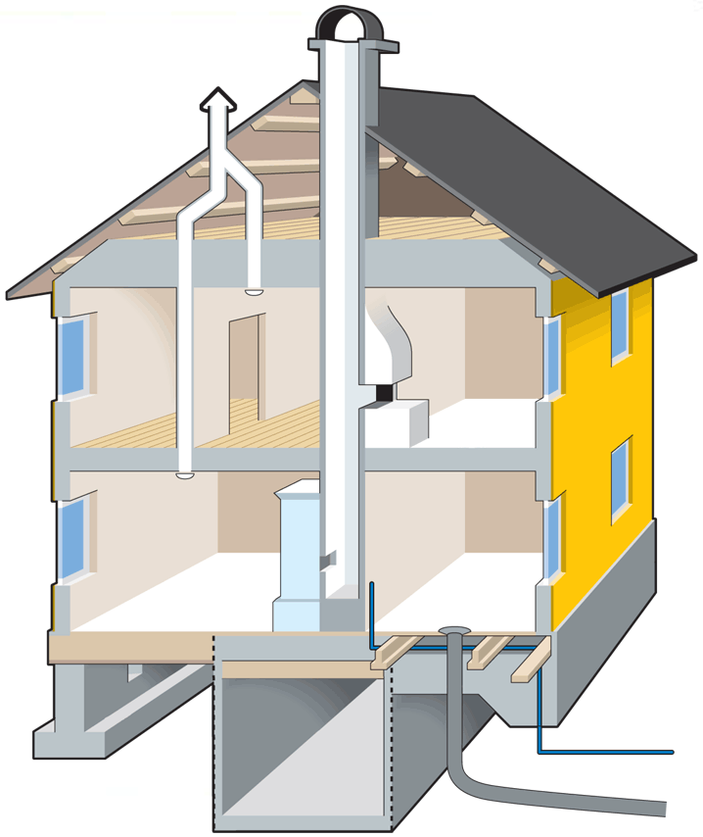
www.ecolivinguk.com
Exhaust Air Heat Pump
A healthy indoor climate means
regular air changes
To prevent the building itself being damaged by damp and mould
To get rid of carbon dioxide
To prevent over heating
To get rid of bad smells
To get rid of moisture
and prevent condensation
To eliminate noxious
Issues caused by
building
materials
© Ecoliving Ltd
micro-renewable solutions for a sustainable future

Slide 20
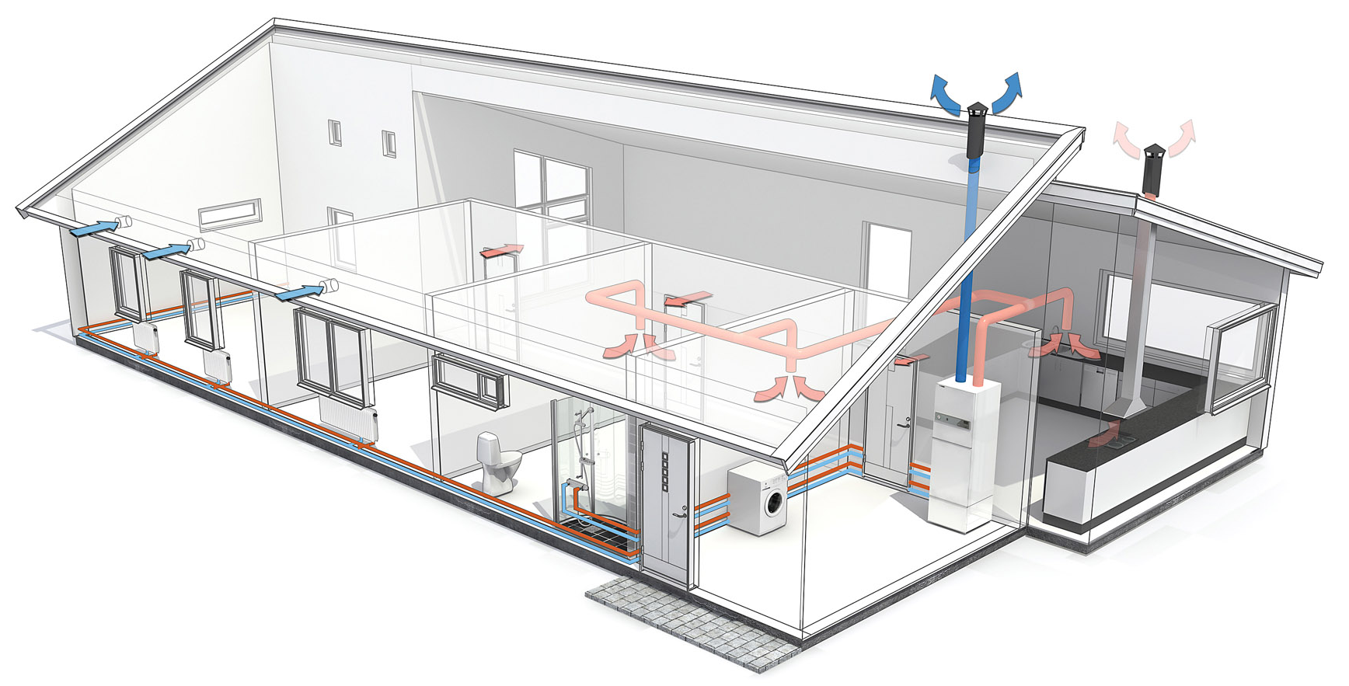
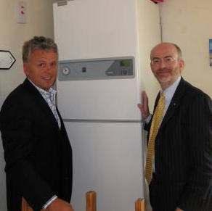
www.ecolivinguk.com
Exhaust Air Heat Pump
NIBE F205 / 360
Heating, Hot Water
& Ventilation
Mechanical ventilation system using
a heat pump. System totally contained
within building envelope
Heats domestic hot water
Heats radiators / UFH
Provides healthy, comfortable indoor climate
Removes damp, stale air & supplies fresh air
Prevents moisture and mould
Energy saving of up to 10,000 kWhrs / year
© Ecoliving Ltd
micro-renewable solutions for a sustainable future

Slide 21
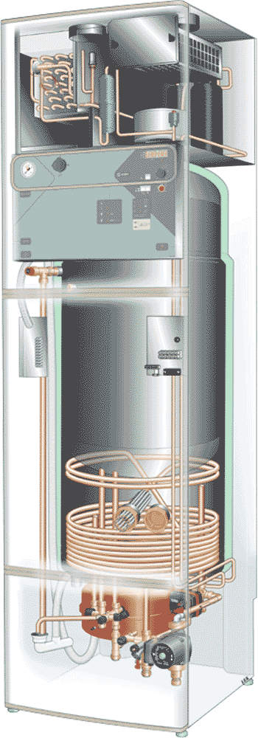
www.ecolivinguk.com
Exhaust Air Heat Pump
NIBE F360
Heating, Hot Water & Ventilation
Designed for low energy flats or houses with heat
loss up to 4.5kW. This equates to a dwelling of
90m2 – 100m2 built to current UK building standards.
Specified in over 80% of new dwellings in Sweden
Heat pump capacity 2kW and immersion heater 6kW.
Built-in 170 litres hot water tank with immersion back-up
Continuous ventilation guarantees ½ air change / hour
Space-saving design - heat pump, hot water cylinder and
ventilation fans all integrated into the one unit the size of a
fridge freezer.
The system replaces the conventional gas condensing
boiler, hot water tank and the heat recovery ventilation
system. No need to bring gas on site!
© Ecoliving Ltd
micro-renewable solutions for a sustainable future

Slide 22
www.ecolivinguk.com
Exhaust Air Heat Pump
Ventilation Design Drawings
© Ecoliving Ltd
micro-renewable solutions for a sustainable future

Slide 23
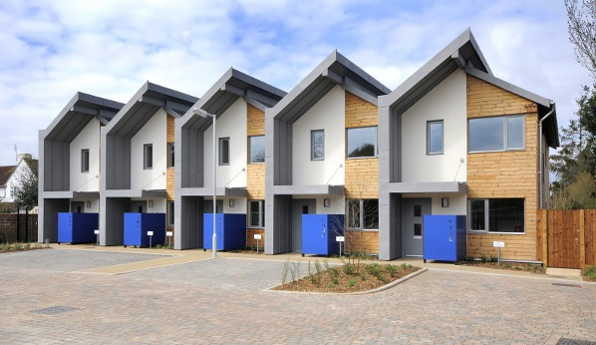
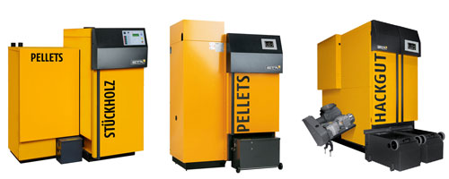
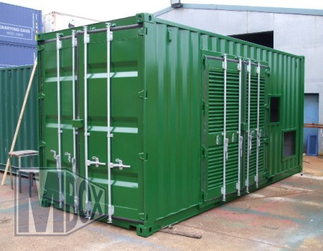

Biomass – District Heating
www.ecolivinguk.com
Stoneham Green near Southampton
Innovative development of two and three-bedroom homes.
The homes which are all for rent are occupied by a mix of young families who were previously overcrowded, and retired couples downsizing to a smaller property.
The housing group opted for a bespoke district heating system based around two 26kW biomass boilers located in one central location which is a pre-packaged plant room.
© Ecoliving Ltd
micro-renewable solutions for a sustainable future

Slide 24
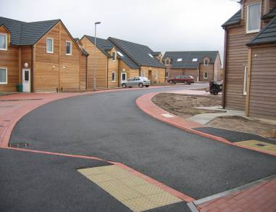
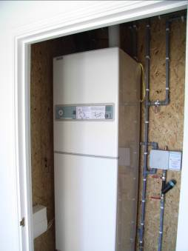
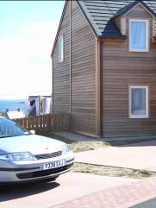

The Citadel
Stromness, Orkney
Client: AHW Building Solutions / ORKNEY HOUSING ASSOCIATION
Property Facts: 15 new affordable homes of 85m2; design & build; off-site SIPs pod construction; high levels of insulation & air-tightness; completed autumn 2006 Heat Demand: 3 kW approx Heat Pump Facts: Installed in each home – NIBE Fighter 360 Heat Recovery (air to water) Heat Pump Energy Saving: 5,000 – 6,000 kWh/year (approx 45%)
Terry O’Hara, MD of AHW provides some background. “With high levels of air-tightness, it is imperative to get the moisture out of the building and replace it with fresh air in a controlled way that doesn’t undermine energy efficiency. As Ecoliving showed us, this challenge was solved by the Swedes in the early 1980s with the development of the heat recovery heat pump which recovers about 50% of the heat within the home, upgrades it via the refrigeration process, and delivers heating and hot water as well as whole house ventilation. This is the solution we chose from innovative Swedish manufacturer NIBE and the result is a healthy, very comfortable indoor climate.”
Sally Inkster, Chief Executive of Orkney Housing Association commented “The project has enabled us to provide good quality, environmentally friendly homes to 15 households in an area which was badly in need of new, affordable housing.
The project fits well with our Sustainability Policy.”
Winter 2006 / 2007 Average bills for heating, hot water and ventilation were £12 / week during the coldest period Dec – Feb.
CASE STUDY
www.ecolivinguk.com

Slide 25

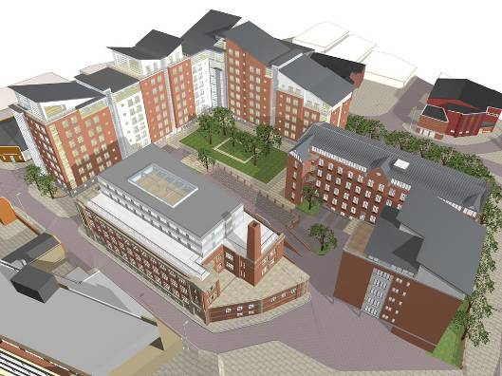
www.ecolivinguk.com
Case Study
Metropolitan Housing Trust
Leicester Square, Leicester
Heat losses (new build) 1.5 – 3.5kw
NIBE Exhaust Air F200 heat pumps
300 units installed
Estimated running costs below £350/year
Estimated 30% reduction in carbon compared to building reg’s standard home with gas condensing boiler
micro-renewable solutions for a sustainable future

Slide 26

www.ecolivinguk.com
Case Study
Lochalsh & Skye Housing Association – Fuel Cost Savings
© Ecoliving Ltd
micro-renewable solutions for a sustainable future

Slide 27
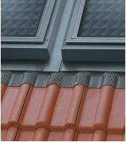
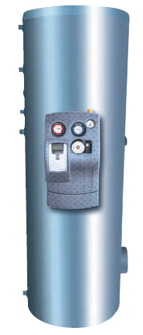

www.ecolivinguk.com
Solar Thermal
- Domestic Hot Water
Solar thermal panels on the roof will provide approximately 60%
of the annual hot water requirement with the balance supplied
via an integrated immersion heater / other heat source
VELUX Solar System
Annual solar radiation per m2 is 1000 – 1286 kWh/year
depending on location.
Based on a family of four, an annual DHW demand of
approx. 4,000 kWh/year, 5m2 of solar collectors and
a 280 litre hot water tank, approx. 2,500 kWh/year
will be provided by the solar and the balance by the
immersion heater.
© Ecoliving Ltd
micro-renewable solutions for a sustainable future

Slide 28
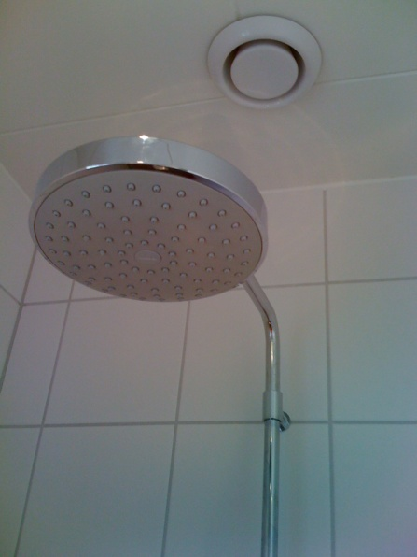
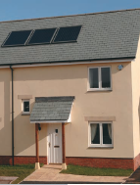
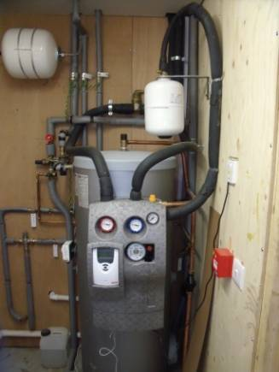
www.ecolivinguk.com
Solar Thermal
- Domestic Hot Water
VELUX Solar System
Complete VELUX Solar Thermal Systems
Solar collectors and an unvented hot
water tank, control panel, pump, roof flashings etc.
© Ecoliving Ltd
micro-renewable solutions for a sustainable future

Slide 29

www.ecolivinguk.com
Solar Photovoltaic
- On-site Microgeneration
Solar PV System
Complete systems including panel array, roof fixings, inverter, cabling etc.
Moving towards zero-carbon ecoliving and Level 6 of the Code for Sustainable Homes
© Ecoliving Ltd
micro-renewable solutions for a sustainable future

Slide 30
www.ecolivinguk.com
RSL - Ecoliving Partnering Methodology
Pre-start to Design Approval
Design Proposal and
Recommendations
TENANT
RSL
Ecoliving Design Team prepare proposal
Needs of the Tenant, Property, Location
Report and recommendations
submitted for approval
Heat Source / Distribution /
Insulation / Improvements
RSL provides list of properties
recommended for heating upgrade
Ecoliving appoints Project Leaders
Liaise with Tenant through introduction
and appointment procedure
Site Survey and
Consultation
Detailed site survey /
SAP assessment
RSL REP and Maintenance Team attend as required
© Ecoliving Ltd
micro-renewable solutions for a sustainable future

Slide 31
www.ecolivinguk.com
RSL - Ecoliving Partnering Methodology
Design Approval to Commissioning
Follow up
Follow up contact with tenant
Inspect and adjust as required.
…..and follow up again
Essential follow up call and or visit to check all expectations are being met
Schedule of Works
Prepared
Commissioning and
Handover
TENANT
Pre start site meeting with installer
RSL and Tenant
Approved by Tenant
Approved by RSL
System commissioned by specially
trained engineer
Bespoke “How to use guide” and
personal handover to tenant.
Installation
Installation carried out as per schedule
Reactive to unforeseeable issues
Multi skilled teams
Where appropriate removal and disposal of existing system
System left operational prior to Commissioning and handover
© Ecoliving Ltd
micro-renewable solutions for a sustainable future

Slide 32
www.ecolivinguk.com
RSL - Ecoliving Partnering Methodology
Typical Timescales
Second follow up
approx 6 months
from installation
First follow up
14 - 21 days from
commissioning
Snagging completed
Site Visit and Survey
Approx 1 hour
Annual Health Check and Service
“BENCHMARK” 5 year plan
Commissioning and
handover approx 7 to 10 days after installation
Snagging list prepared
if required
Installation
Approx 3 /5days
© Ecoliving Ltd
micro-renewable solutions for a sustainable future

Slide 33
www.ecolivinguk.com
RSL - Ecoliving Partnering Methodology
Aftercare Support
Tenant
General Operation
Query
System Fault
RSL Maintenance
Team
Ecoliving Technical
Support
Installer
Ecoliving Technical
Engineer
© Ecoliving Ltd
Manufacturer’s Support
micro-renewable solutions for a sustainable future

Slide 34

www.ecolivinguk.com
We welcome
your enquiries.
We look forward to helping you address fuel poverty, reduce carbon emissions and create a sustainable, warm and healthy indoor climate for clients!
Thank you for your attention!
Frank McElroy
Frank.mcelroy@ecolivinguk.com
www.ecolivinguk.com
© Ecoliving Ltd
Tel: +44 (0)845 301 3121
micro-renewable solutions for a sustainable future

