Slide 1
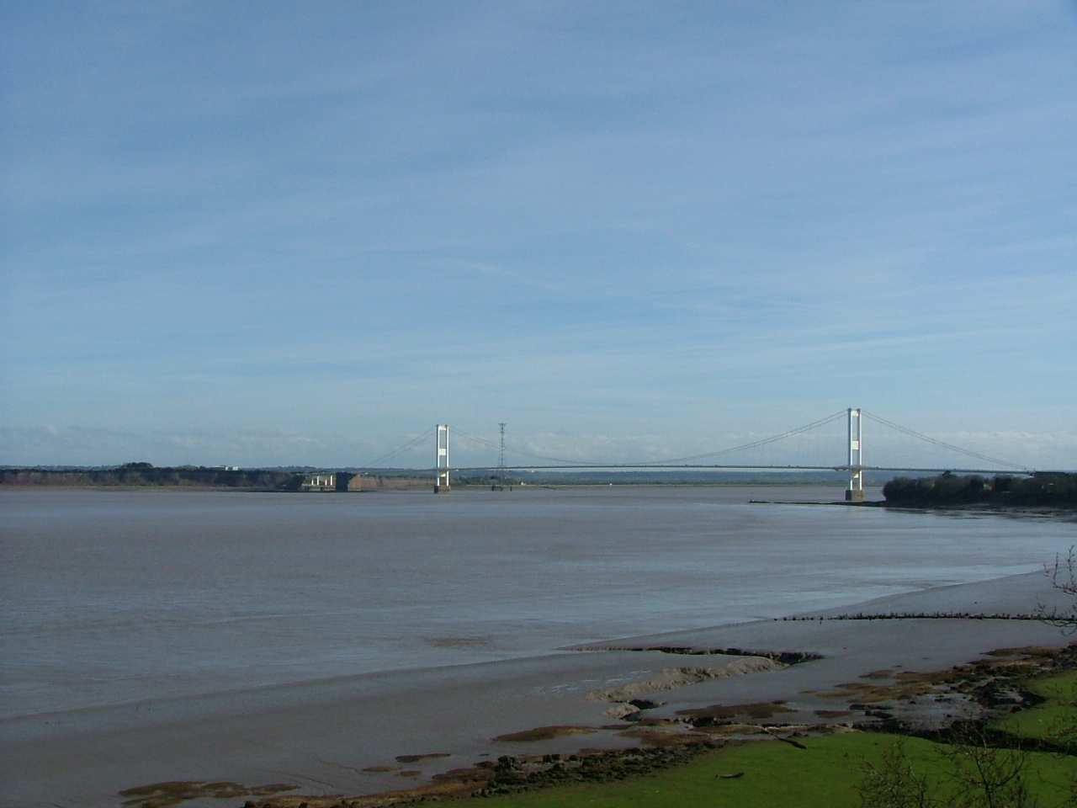
The future relationship between CCH and the London Federation of Housing Co-ops

Slide 2
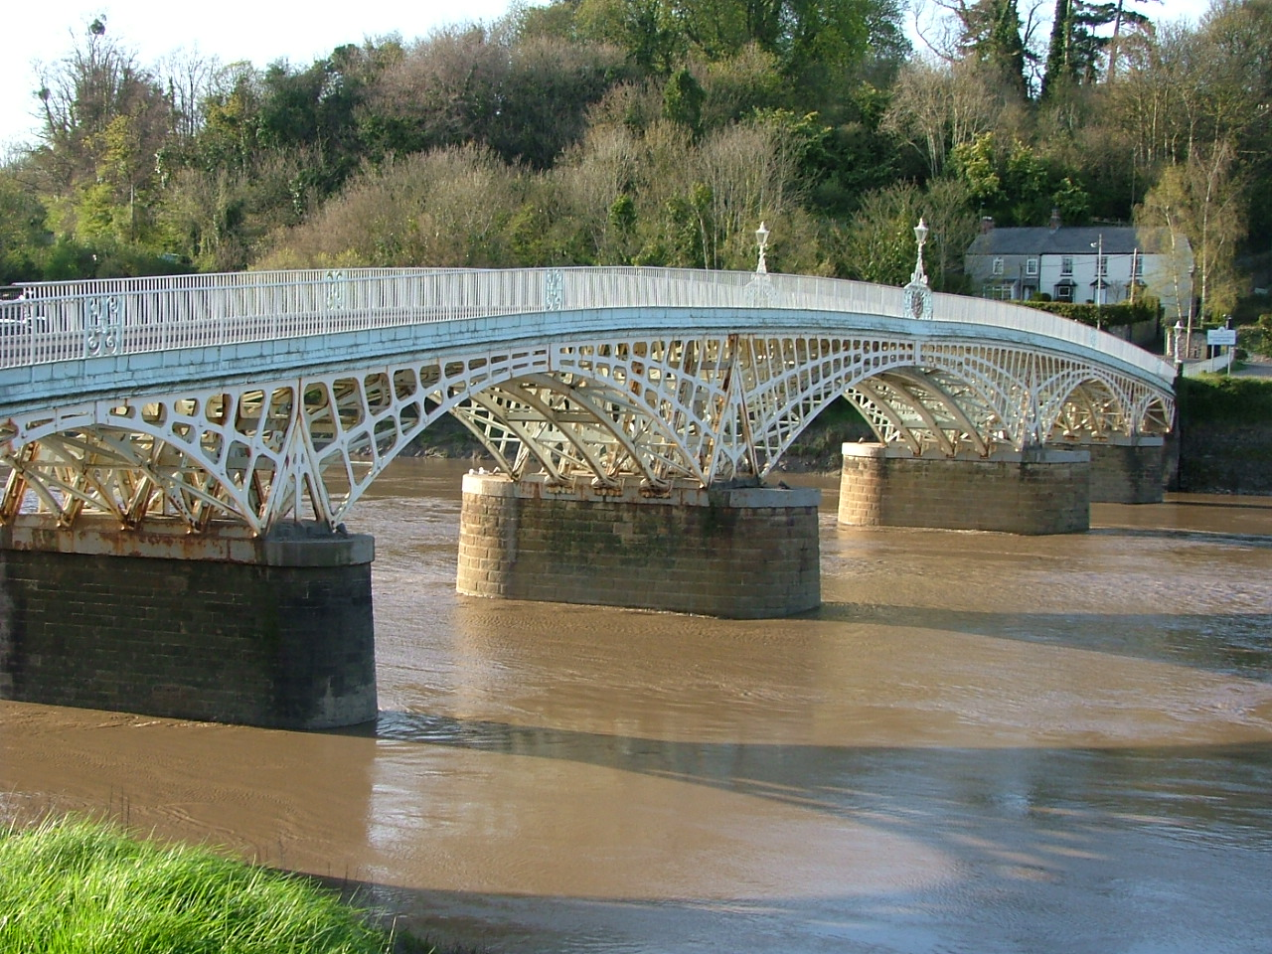
CCH review process in 2013 Implementation from CCH conference in July 2014

Slide 3
victims of our own success?
how do we do it? (Not why do it?)
mainstreaming co-operative housing?
the future of our movement?

Slide 4
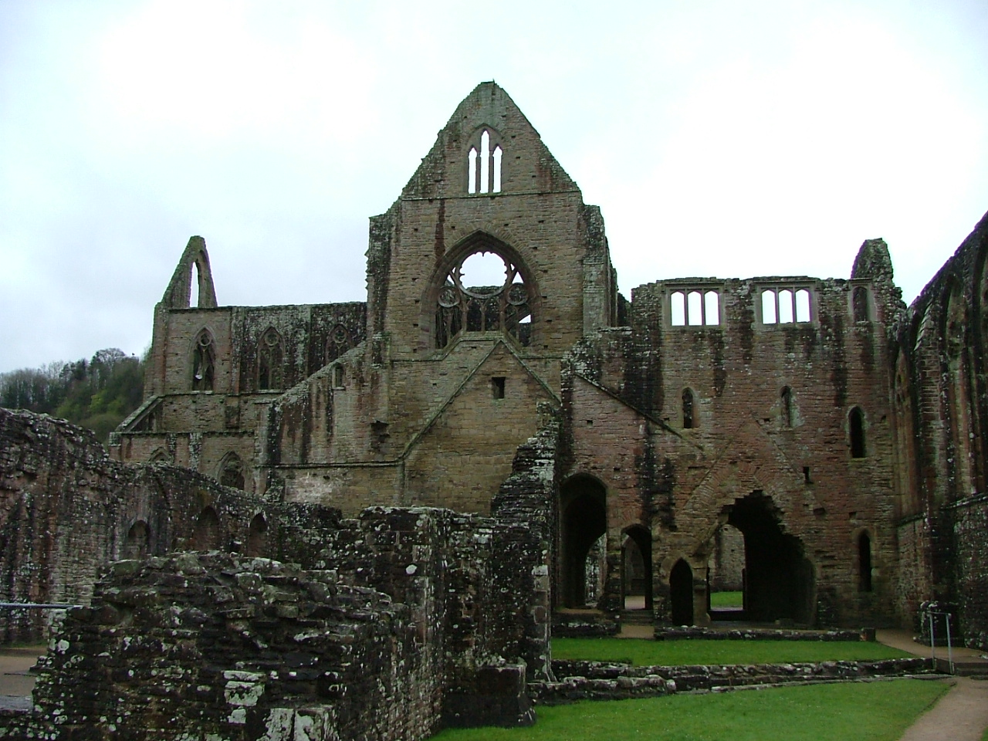
Outcome 1: clarity about membership offer to existing and potential members
Our recent membership consultation programme
Report to be circulated in the Spring

Slide 5
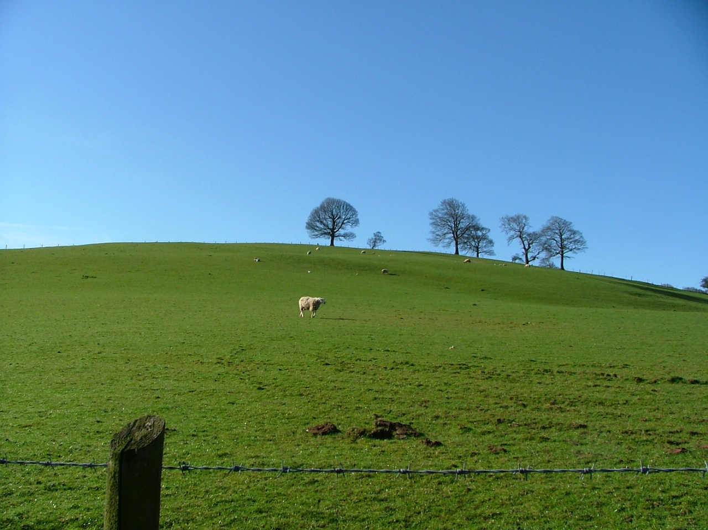
Outcome 2: rationalised governance structure
General membership meeting in November to agree new model articles and secondary rules
Recruited board with appropriate skills to July AGM

Slide 6
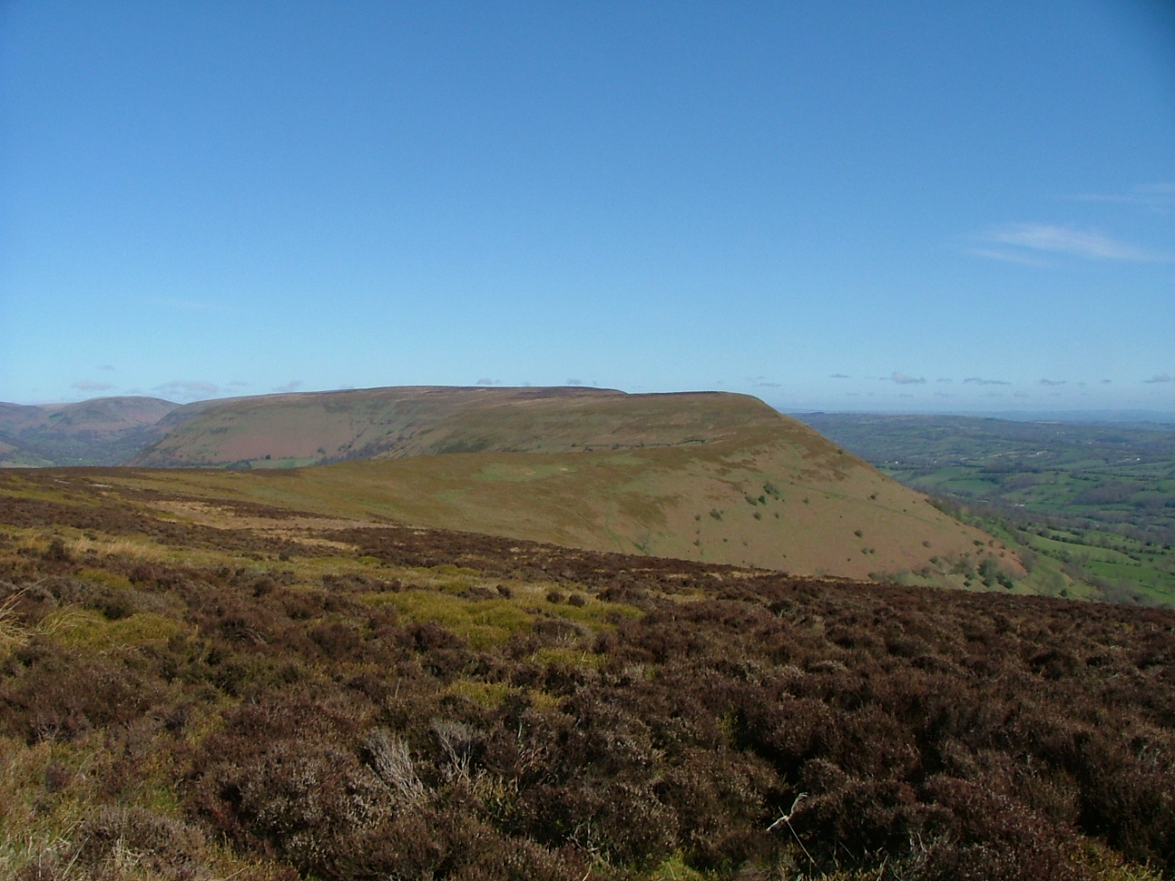
Outcome 3: separation of governance & delivery
Start to employ some staff (some through hours; some through consultancy; some membership support; some strategic) – the beginning of a journey – developing formal structures

Slide 7
a direct CCH membership offer to our members
eg. some CCH members want regional activity
the CCH not in a position to offer full membership benefits to federal members
some initial discussions with some LFHC officers

Slide 8
Option 1 – the LFHC becomes a CCH regional group
a CCH London committee advising on how the CCH operates in London – chaired by a CCH director – members drawn from CCH London members (potentially replicating how LFHC works now)
an identified proportion of CCH resources devoted to London co-operative activity (NB. the CCH already does a lot of work in London)

Slide 9
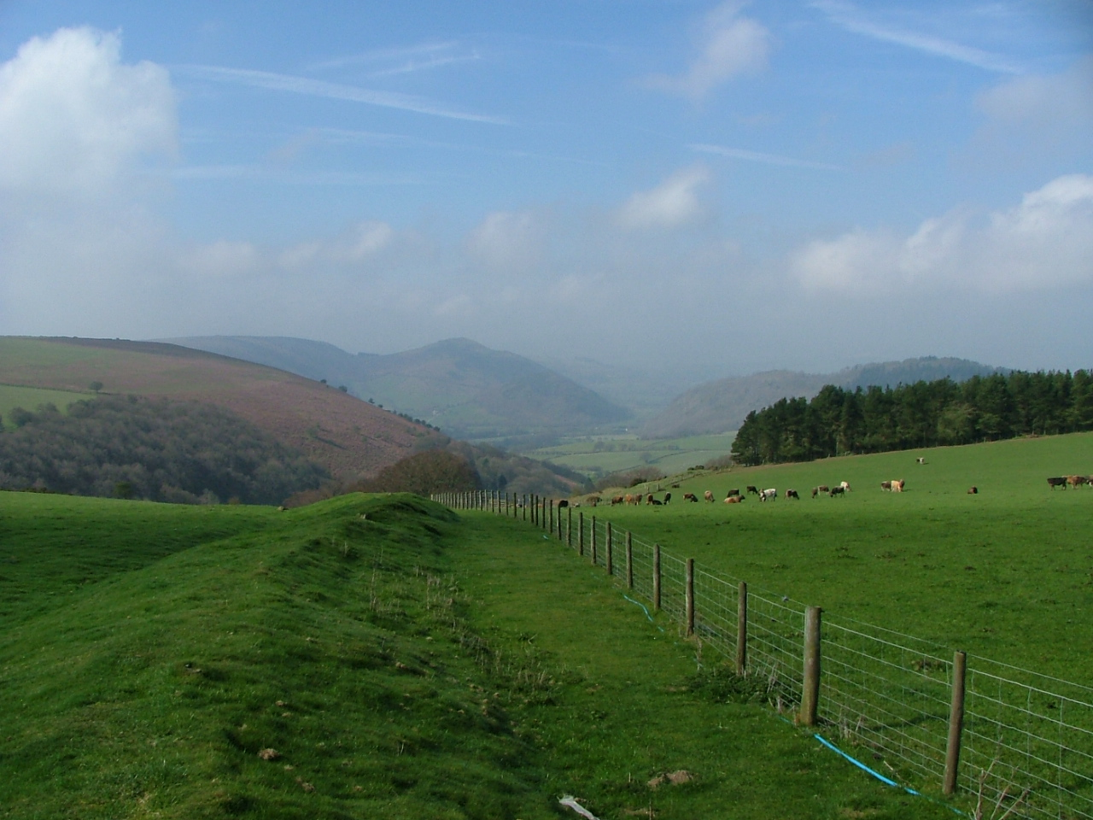
subject to what London CCH members wanted, continuation of Forums
a single arrangement to engage with the GLA and other London bodies
publicity to all LFHC members asking if they wish to be members of the merged body
dealing with the problem of duplicate affiliation fees for London housing co-ops
relationship with the NFTMO

Slide 10
Option 2: the LFHC remains independent
LFHC continues to operate as it does now
relationship with CCH would change
the CCH has to respond to our London members (eg. a CCH regional committee; London lobbying)
competition between CCH & LFHC?
confusion for members & for external bodies
NB. CCH partnership relationships with multiple national organisations that operate in London

Slide 11
We would welcome a decision by end of March 2014

Slide 12
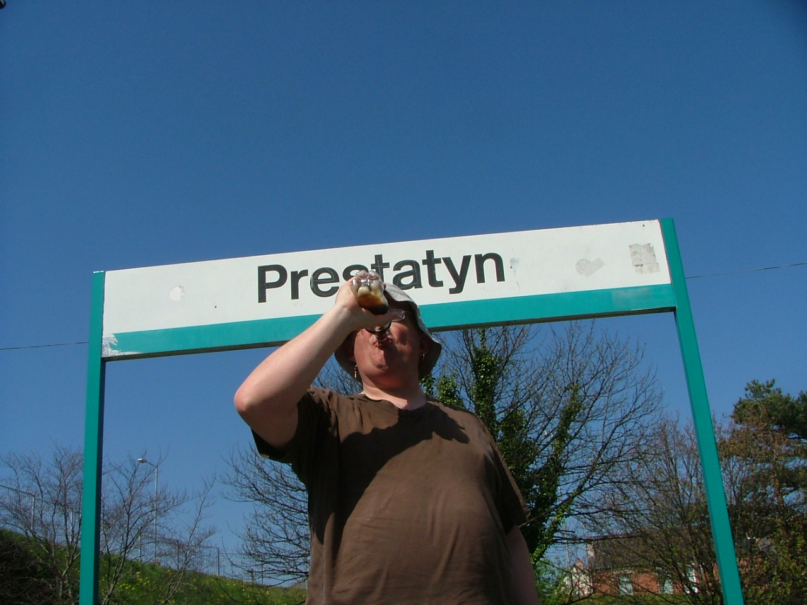
CCH info@cch.coop 07947 019287

