Slide 1

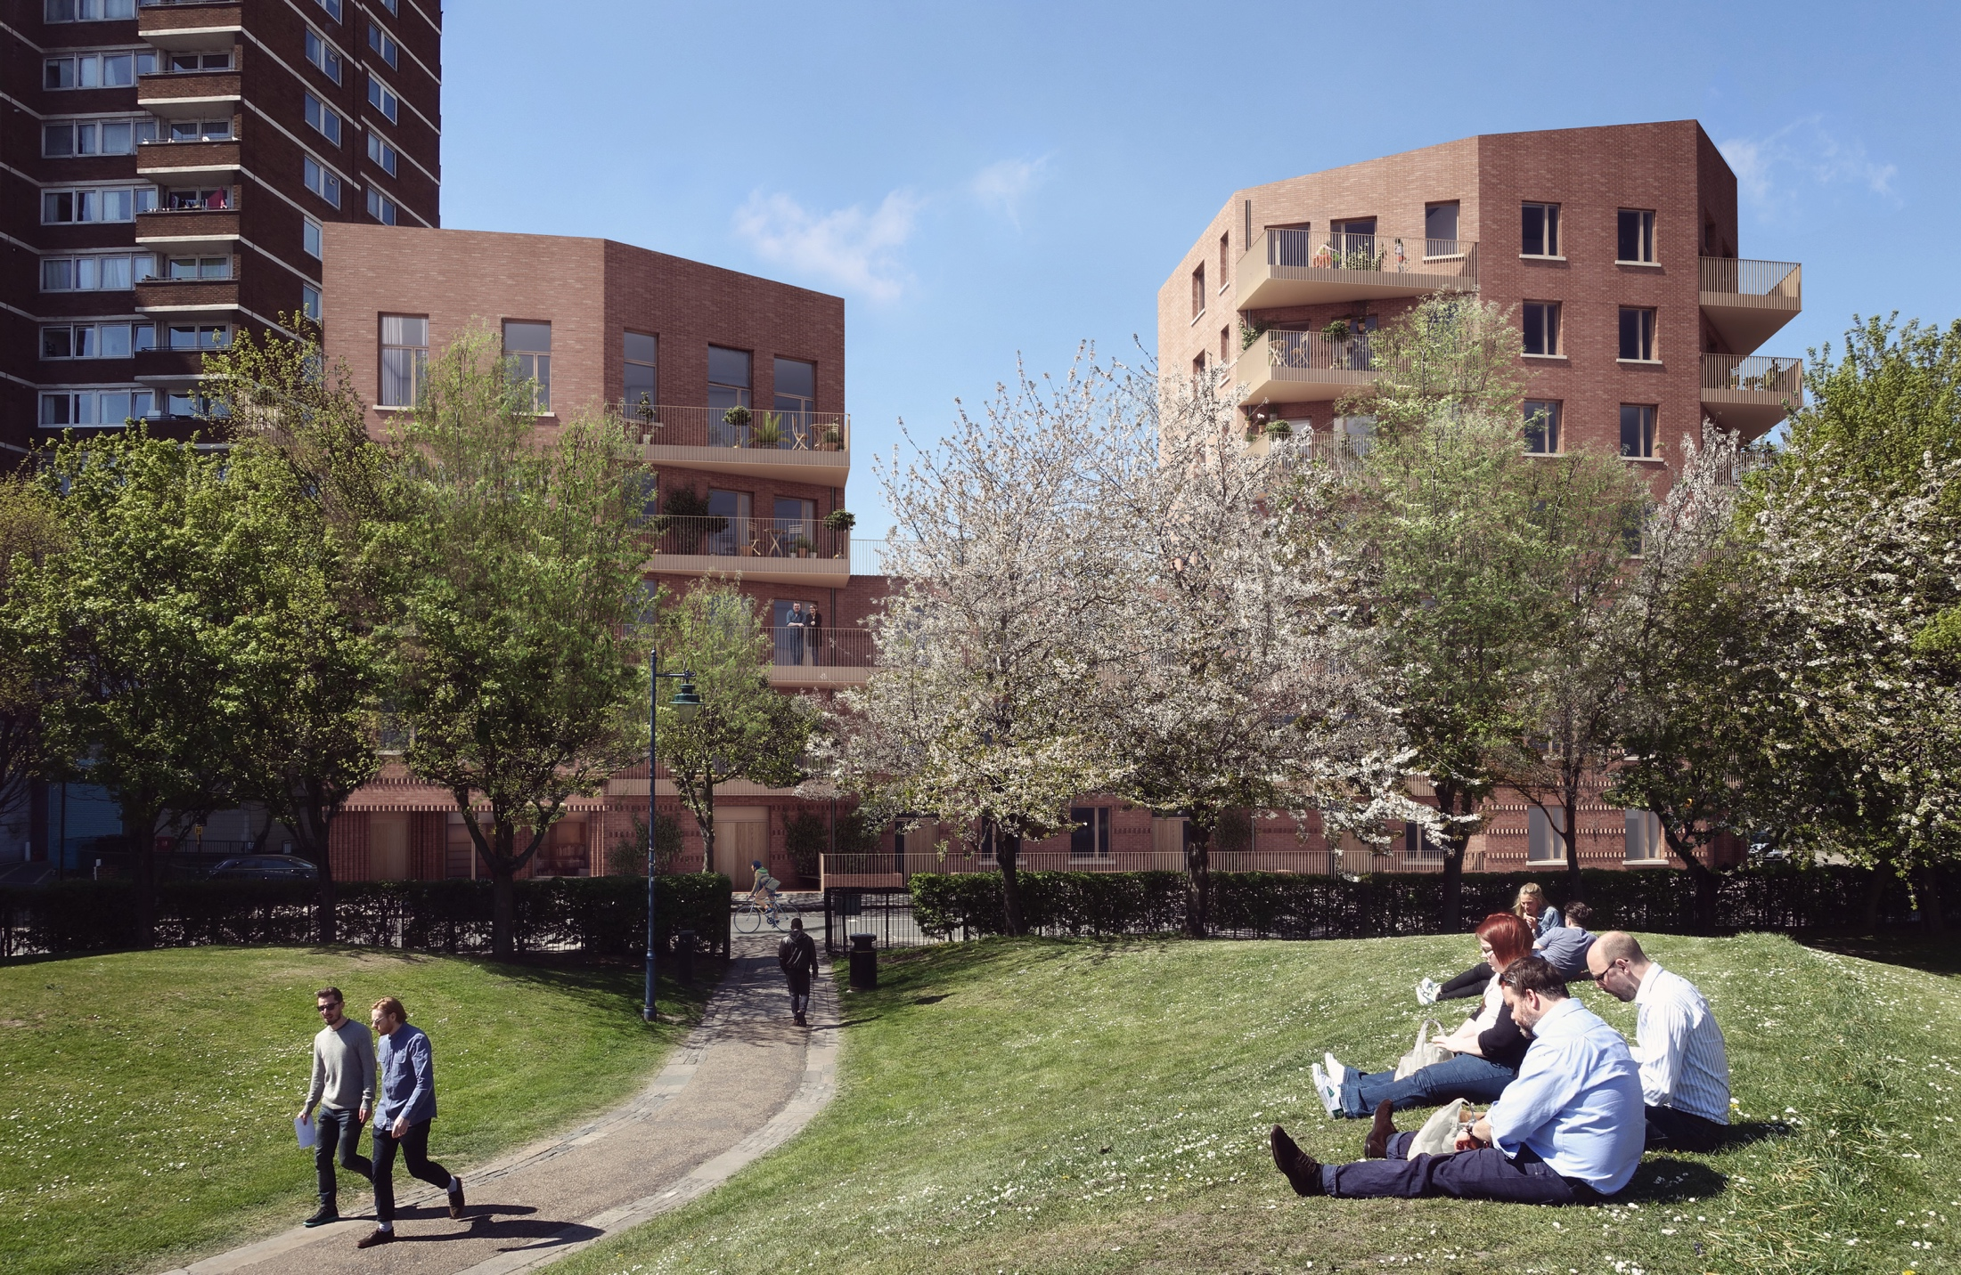
London housing Coops
Andy Bates & Kym Shaen-Carter
17/09/2015
Notes:
Andy to introduce both of us.
JMB manager & CBS director and kym is DM

Slide 2
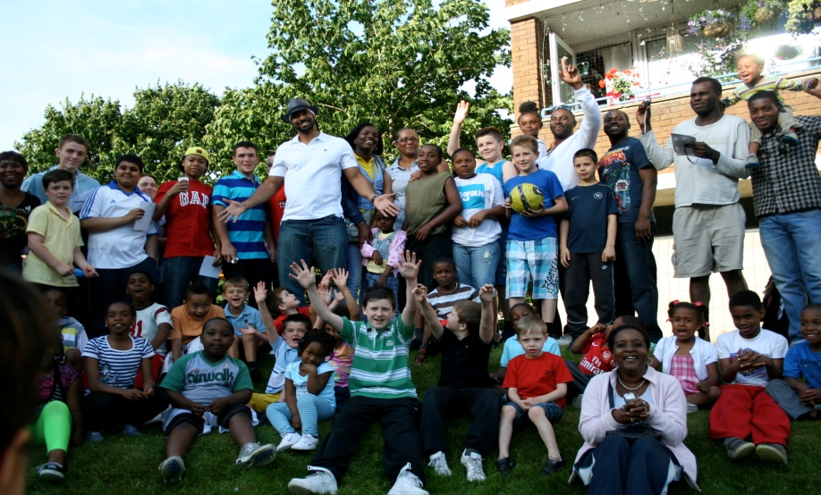
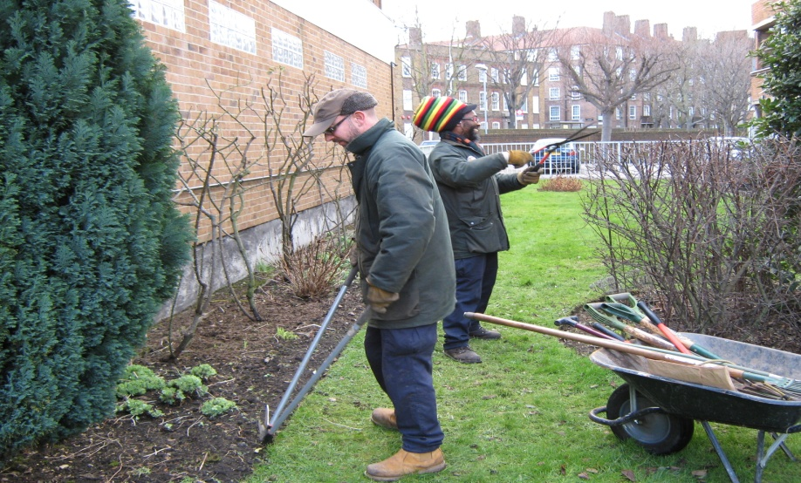
Who are the JMB?
Tenant Managed Organisation
Homes are owned by Southwark and managed by residents
TMO provides full range of housing management services including management of major repairs
JMB manages 1,500 homes of which 1,100 tenants & 400 leaseholders
Est. 1996
3 continuation ballots
78% voted, 93% supported JMB
April 2013 became self-financing
Notes:
Andy

Slide 3
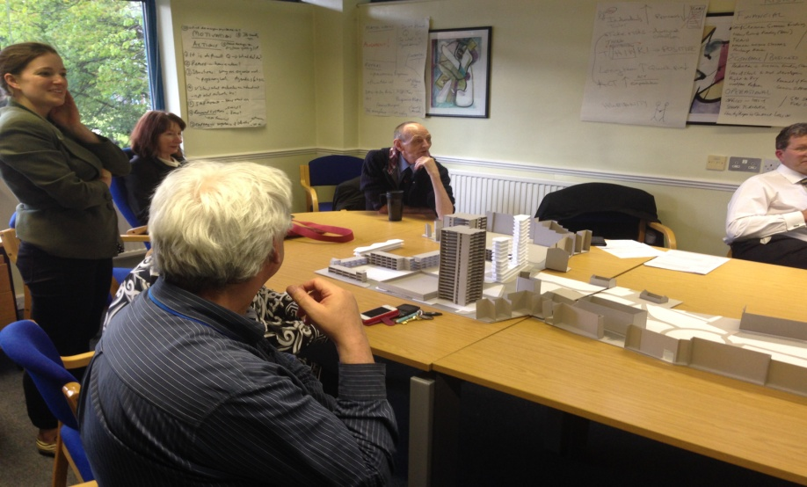
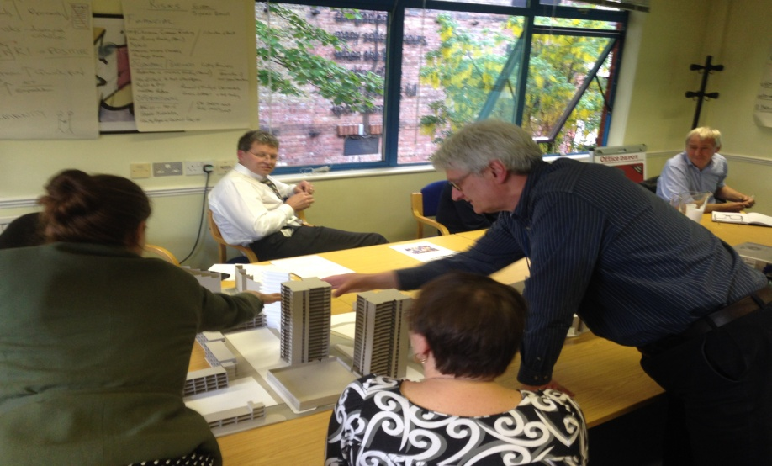
Who are the CBS?
JMB directors established CBS to separate day-to-day housing management from riskier development
Community Benefit Society
Governed by the FCA
New board – some overlap with JMB but new development and regeneration experts attracted.
Not a registered provided
Aim to hold assets for community benefit in perpetuity
Notes:
equivalent to old industrial and providence society

Slide 4
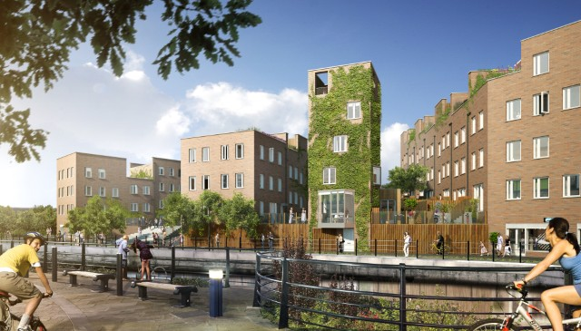
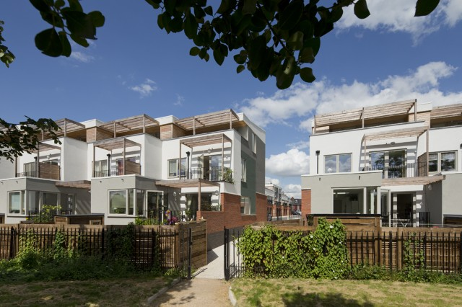
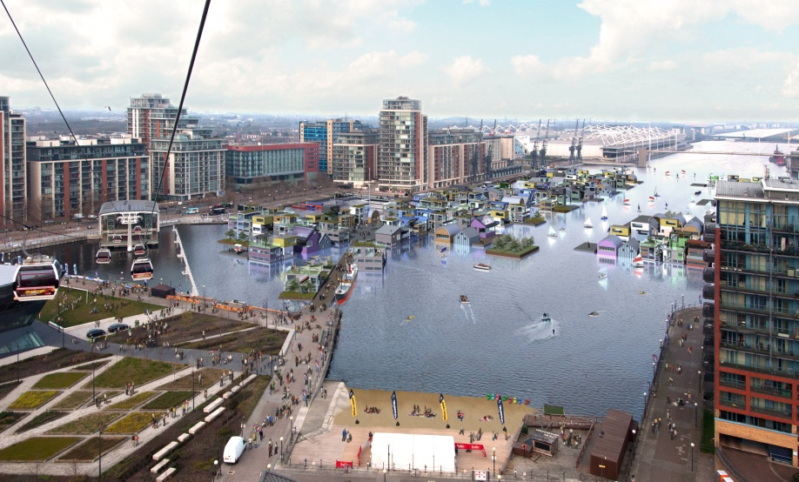
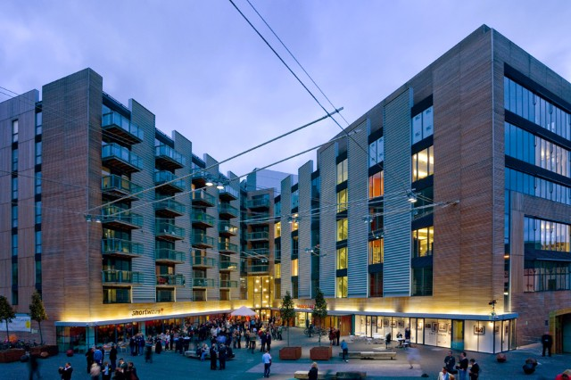
Who are igloo?
igloo is a developer, funder and partner with
people, place and planet at our heart.
Notes:
Kym –
igloo is the UK’s leading responsible real estate business.
As a purpose driven developer, funder and partner, we work with communities, local authorities and investors who want to make the world better one place at a time.
An igloo project has People, Place and Planet at its heart.
Why CLD so important?

Slide 5
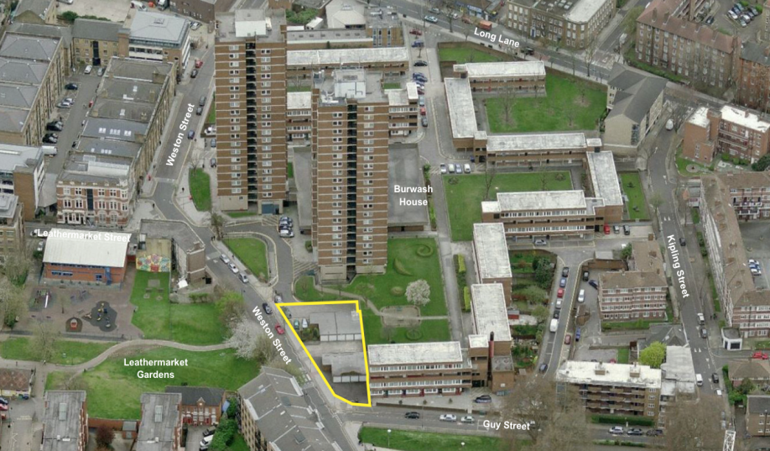
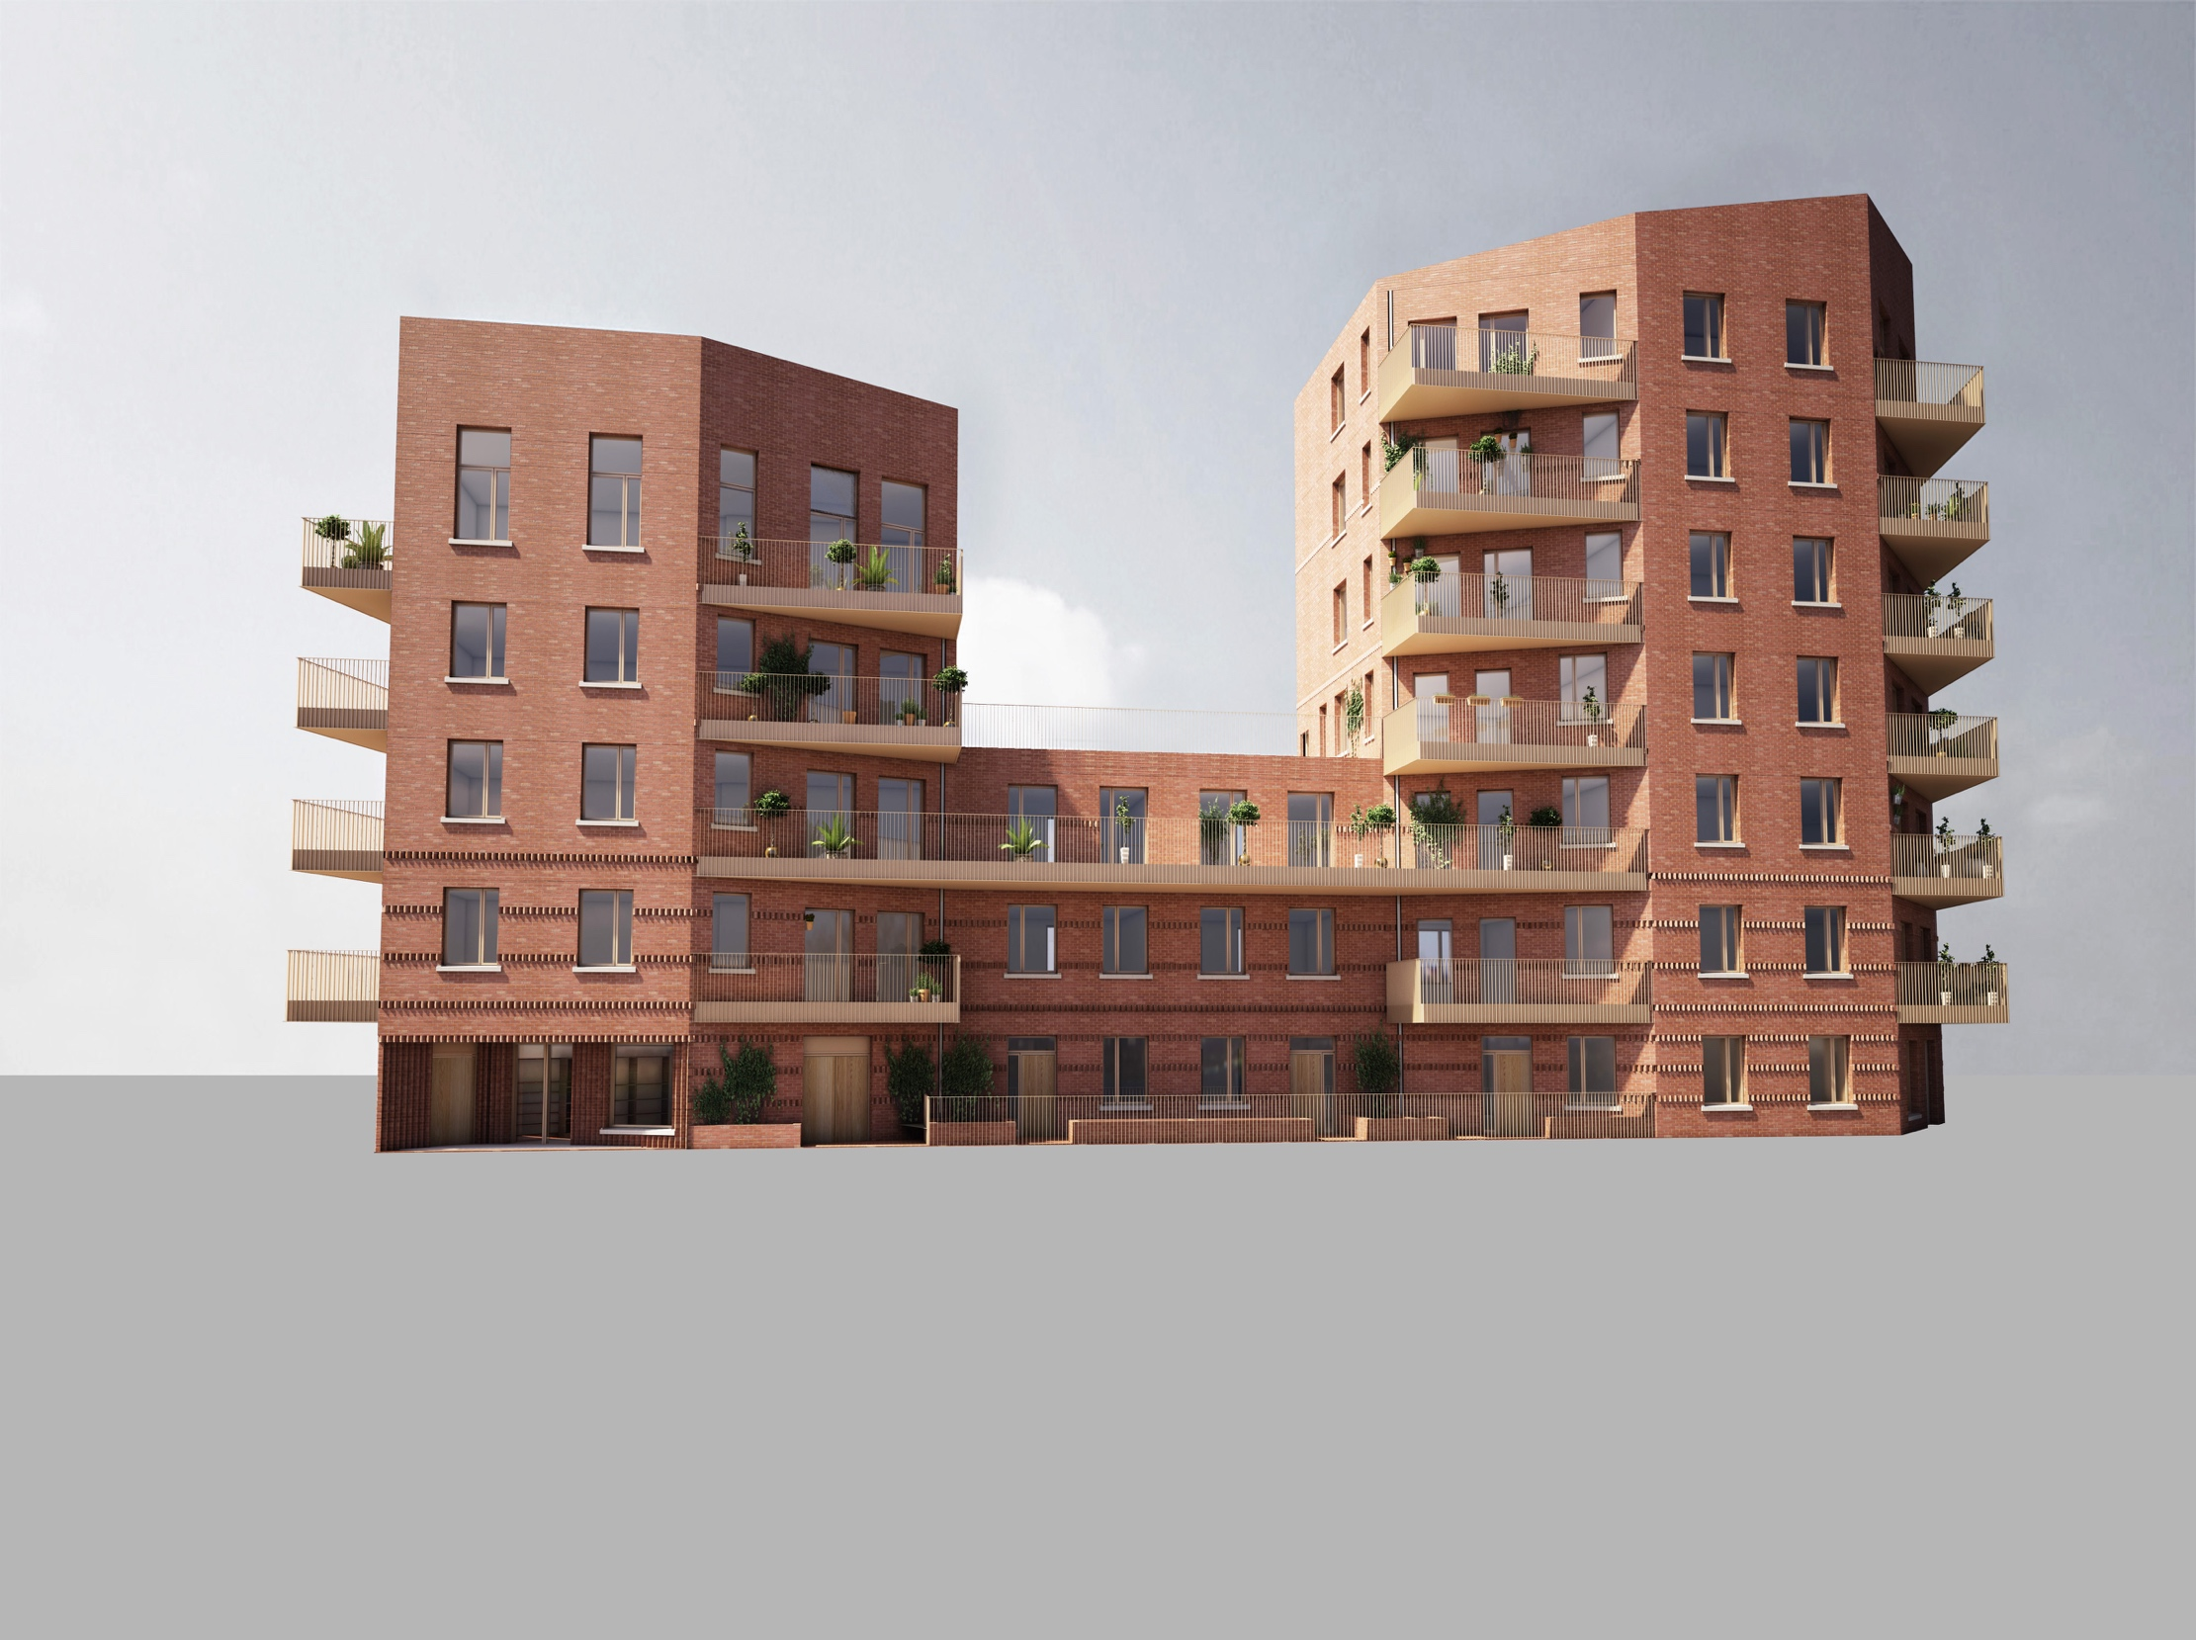
Kipling garages
27 new genuinely affordable homes
located in Bermondsey
100% council rents
No right to buy
Local lettings policy
Custom build
Gross Development Cost (GDC) - £9.5m
GDC per home £350k
Construction cost - £6.3m
Planning Validation – Aug 2015
Start on site – Q2 2016
Completion Q3 2017
Notes:
Former site of 20 lockup garages
history - hg
High value area both for rented or buying.
Kym

Slide 6
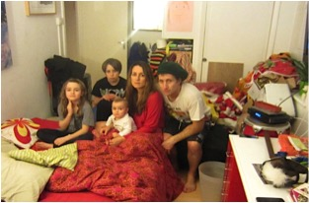
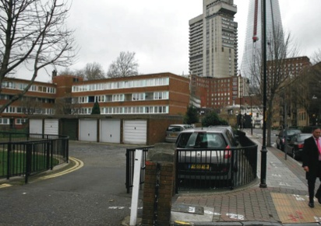
Why develop?
JMB Continuation ballot
99% of JMB residents have a combined household income of under £30,000 [Q4 2012]
Southwark’s Housing Commission - average household income for social housing tenants was £13,000 per year [Q2 2013]. Social rents or nothing....
Resident experience of development happening to them not with them...
Notes:
Andy

Slide 7
Local support
12-18 months of ground work
Cold call survey early 2013: 87% thought new housing is an important issue that JMB should get to work on
6 months contacted 1,100 tenants contacted. 480 face to face interviews. 86% support (a handful said not next to me)
30% of tenants had a substantial reason why they need to move: London dimension 16% of tenants overcrowded
Part of Better Fit local allocations: matching over and under-occupying residents: create a chain of benefit
Notes:
The question is how do you convince local people it’s a good idea.

Slide 8
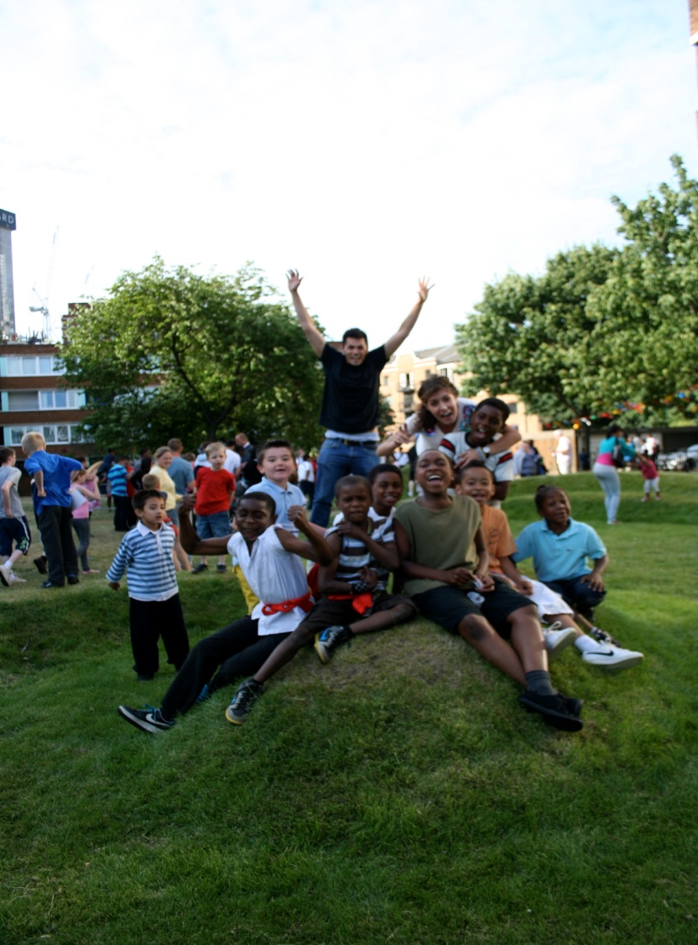
How we got started?
Community Pressure
  Questionnaire results
  Genuinely affordable housing group
  Raising issues with tenants and residents associations
2. Free Advice
Community Vehicle- CBS (mutual)
Development Partner (igloo)
Notes:
Legal advice Anthony Collins- really important that it is a mutual
Development partner- igloo :community ethos. Need a higher of support than a HA with large development section

Slide 9
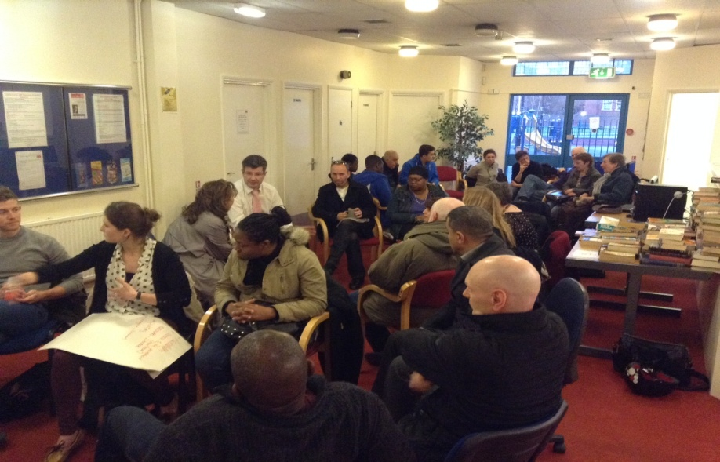
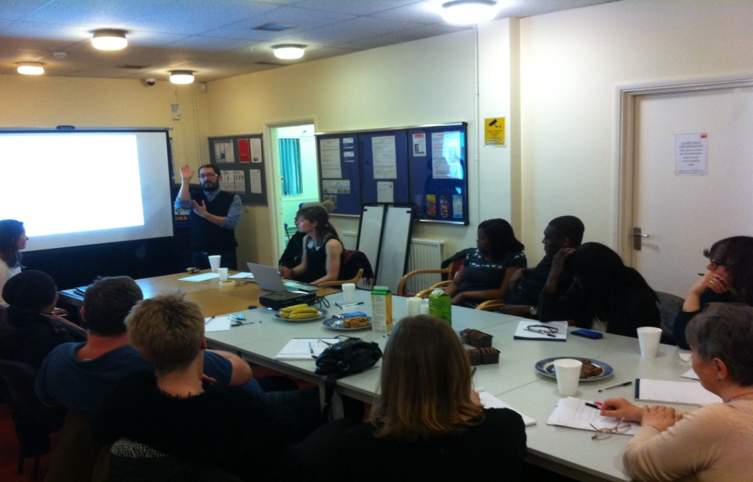
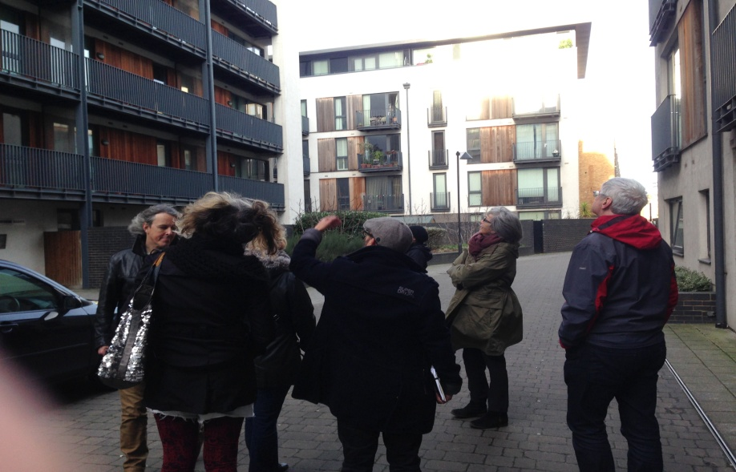
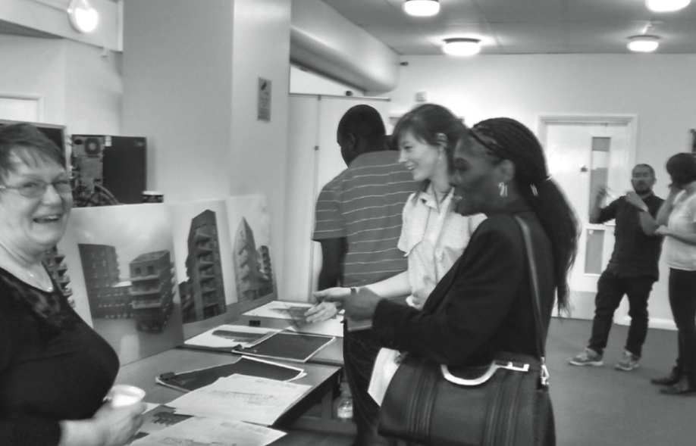
Consultation
Notes:
There was some initial skeptism… particularly from those that lived next door.
However, along with the architects, Bell Phillips we started with a blank sheet of paper and from there we built trust. The key was at each step of this collaborative co-design process we have demonstrated how comments are recorded and how they have influenced the design.
Prior to planning we conducted 8 formal consultation events, and many one to one meetings to discuss any particular concerns. We used a variety of methods to engage with people including a walking tours, focus groups, one on one sessions, and presentations…
Success of these events has been demonstrated by excellent ongoing attendance to these events and initial concerns turning into positive support.

Slide 10


Feasibility
Grant
  Urban CLT Fund
    Three days of expert advice
    £4,000 for legal advice to incorporate a new CLT or secure land, to prepare your business plan, to cover some technical costs or community engagement costs.
  GLA/HCA: (CRTB) At the time, feasibility grants of up to £178,000 were available.
  Grants from local charities or organisations
Sweat Equity
Pro-bono advice
JMB £200,000 contribution (cash flow)
Notes:
Funding
We secured c£350k as we were 100% affordable housing and state aid did not therefore apply.
What did the CBS use this money for?

Slide 11
Construction to completion
Land transfer – agreement to lease / lease
Allocations
  Local lettings policy
  100% on this custom build project
  50% across three named local sites
Funding agreement
  100% of the remaining funding required up to a stated maximum (based on current estimate of GDC + 5%).
  Interim funding: RIBA Stage D to start on site.
  Drawn down quarterly in advance
  Southwark Council will include as part of 11,000 homes target
Notes:
Funding
The first step is to identify a potential site, work out who owns it and then agree to acquire it.

Slide 12
Community led development
The JMB/CBS is respect and trusted
Unlock challenging sites
Great people have given their time for free
Residents want to be involved and listened to
Communities have a wealth of knowledge and understanding of the local area. This is key for developments to knit into the local areas
Absolute focus on this development- not diverse objectives of large organisation
Communities and people are more proud of something they have helped to build

Slide 13
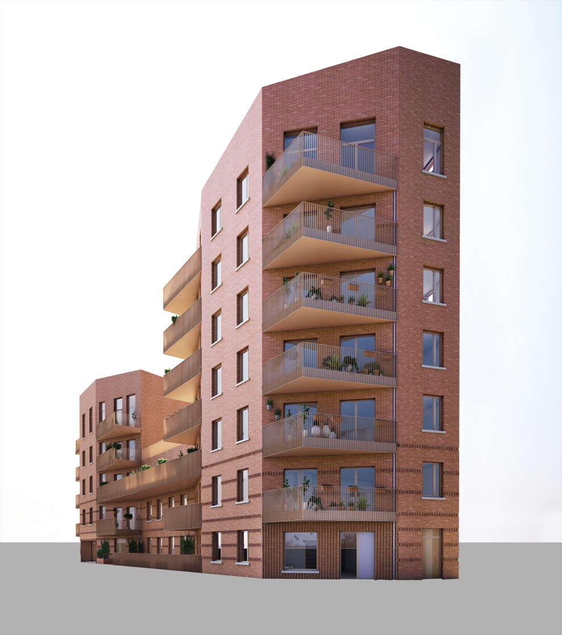
Lessons learnt
Take time to galvanise your community
Strong and consistent political support is vital
This is a new model for local authorities and their lawyers
Risk management – legal constitution & professional team to manage risks
Demonstrate tight financial control
An innovative approach takes time – the first time

Slide 14
Residents comments
“After attending many meetings with the CBS and residents I am very pleased to see the possible final design of this new block.”
“Very happy with the indoor plan for our flat, when can we move in? “
“Nice and lovely. I love everything about this beautiful building. Proud to be involved. I can’t even wait for the building to be completed.”
“This is a very attractive building. I will miss my view across to Canary Wharf but I hope this building will provide beautiful homes for many people.”
“This is an excellent job. The building is beautiful and I can’t wait to see the building completed.”
“Very exciting to see what’s possible when estate residents feel empowered to make these new homes happen, to be part of the process of building new homes; there has been so much trouble taken by the JMB and the architects to make this a full community enterprise that will have a good result. I think the final design will enhance the estate and also feel sure that people living in the new homes will have a very good quality environment. I hope this scheme is approved and inspires other developments in my community.”
“Keen to see more council run JMB properties built across Southwark therefore support the project and pleased to see local people consulted in the design process.”

Slide 15
Kym Shaen-Carter
igloo Regeneration
Kym.shaen-carter@igloo.uk.net
07702214300
Andy Bates
Leathermarket JMB / CBS
Andy.Bates@Leathermarketjmb.org.uk
020-7450 8021

