Slide 1
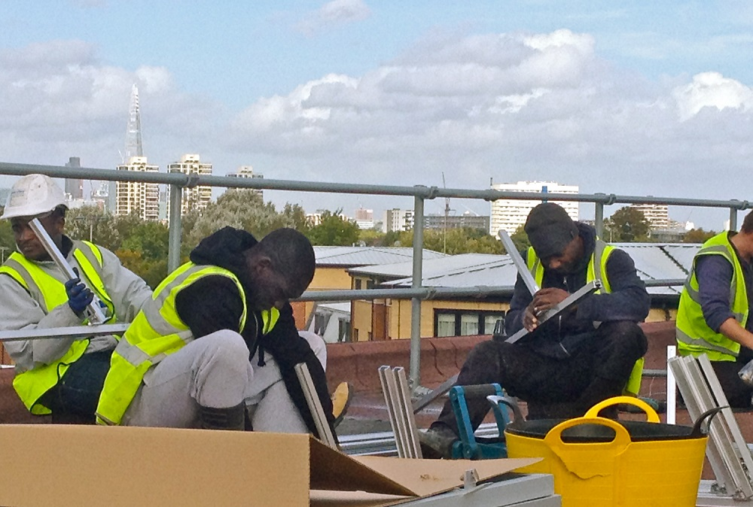
Creating Local Energy
Afsheen Kabir Rashid
Co-founder Director

Slide 2
Content
About Repowering
Co-operative model
What we do
Our projects
Legal and technical

Slide 3
Who we are
REPOWERING is a Community Benefit Society
Creating local energy:
We specialise in co-producing community-owned renewable energy projects
Our Vision:
To create resilient, empowered communities that control and own the generation and usage of renewable energy.

Slide 4
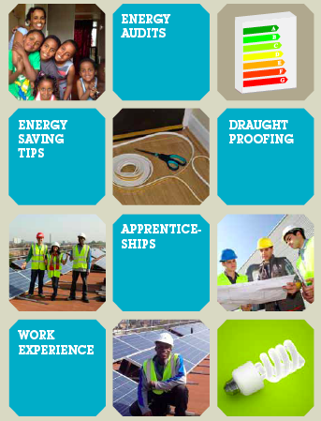
Our Journey
…it’s all about wellbeing!
Lambeth is the 5th most deprived area in London and the 22nd most deprived in England.
As a key focal point within Lambeth, Brixton gave us the chance to address some serious problems.
Values:
To allow people to invest in themselves & their community
To allow people to gain financially through socially responsible investment
To promote energy efficiency through education, home energy audits, etc
To provide apprenticeships and work experience for local people

Slide 5
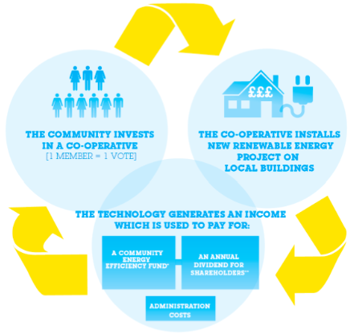
5
Community Energy model
Community ownership, management and benefits

Slide 6
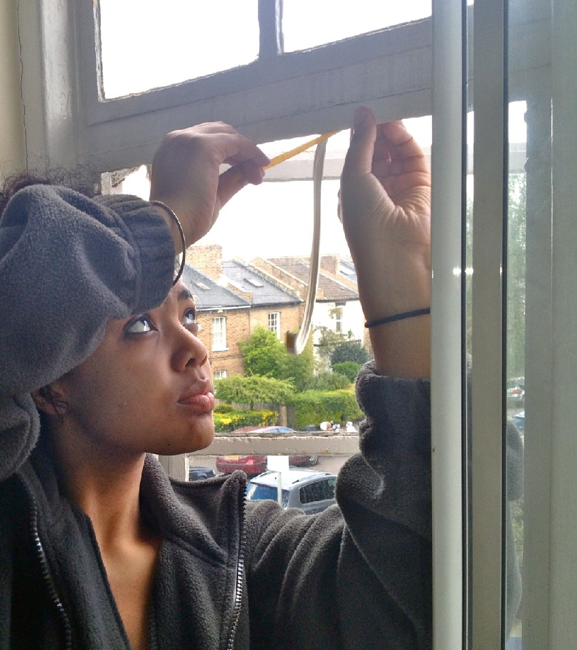
Social works programme
Asking what people want.
Community Engagement
Existing networks
Door knocking
Energy surveys
Events
Co-production
Mentoring sessions
Monthly public meetings
Energy efficiency workshops
Training
30 week internship
Energy efficiency training
Paid work experience

Slide 7
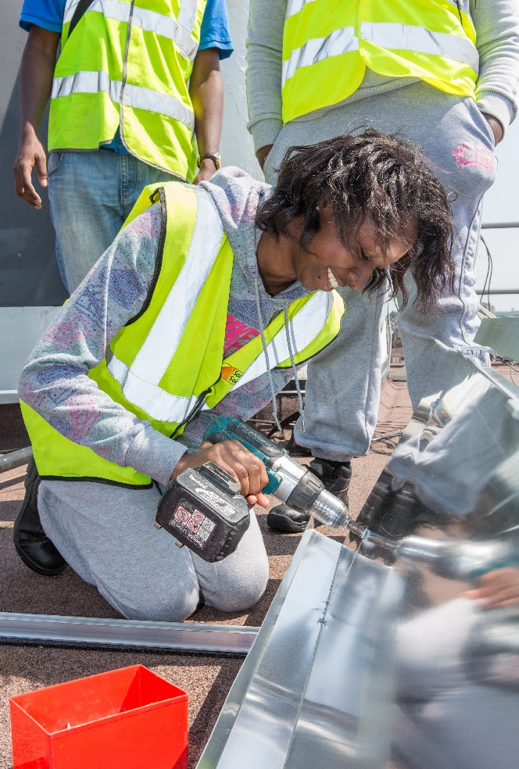
Training and work experience

Slide 8
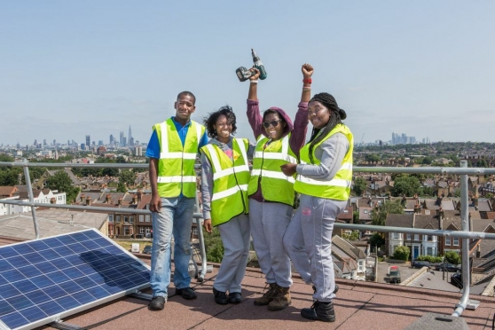
Empowerment

Slide 9
Our Projects
234 kWp installed solar PV
£325,500 raised through community shares
Mentored 40 local volunteers
Training work experience for 34 local youth
£67,000 towards Community fund
3-4% ROI
Streatham Power
Repowering, acts as an enabler and mentor

Slide 10
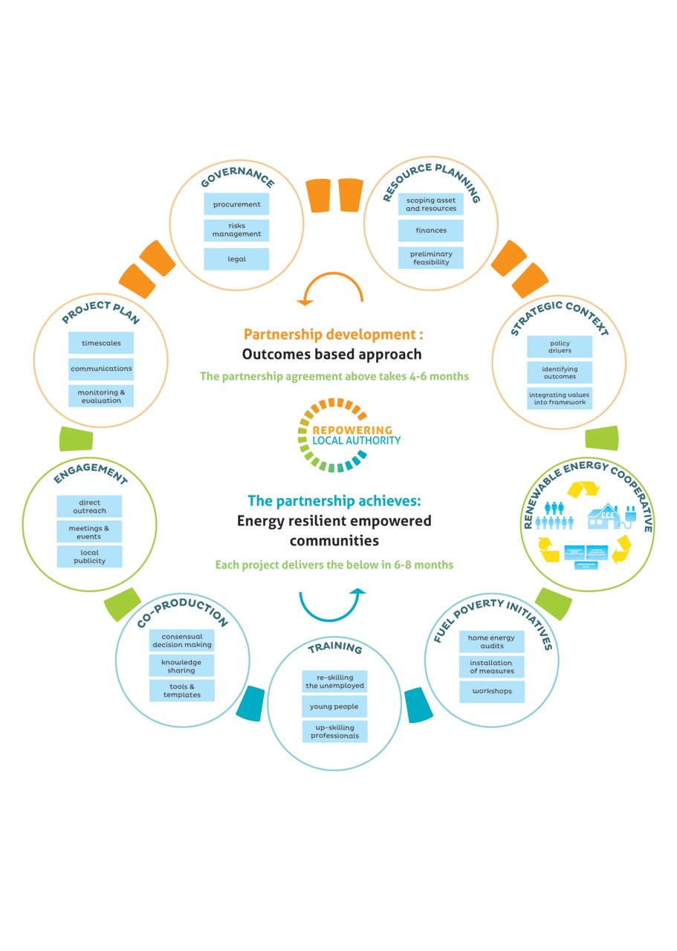
Key Partners: Local Authorities
We are currently working with:
Lambeth Council
Hackney Council
Harrow Council
Kensington & Chelsea Council
Woughton Community Council

Slide 11
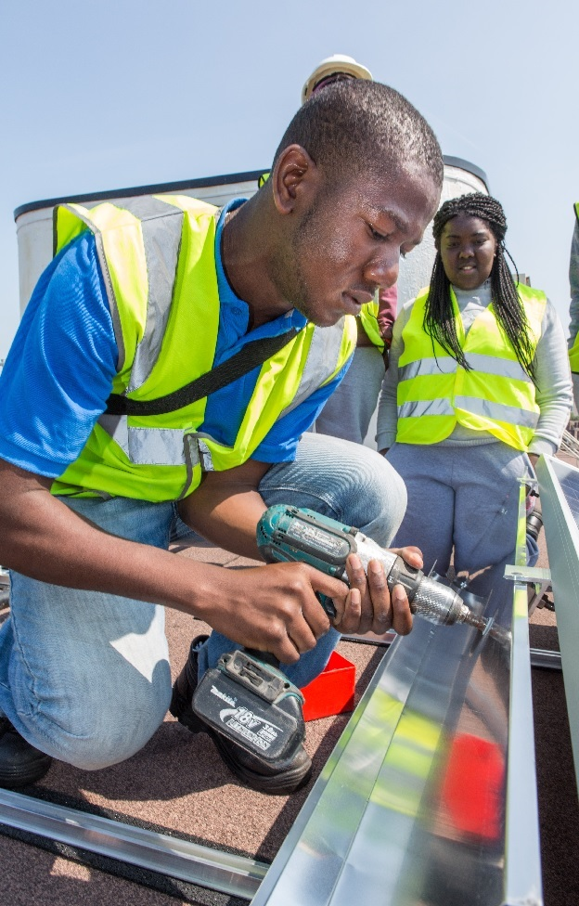
Legal and Technical
Legal
Lease agreement held with Co-operative Society and building owner
No additional cost to Leaseholders
Building owner responsible for roof repair and maintenance. Co-operative responsible for panels
Technical
Panels installed on sound roofs
Insurance covers loss of income due to damage
Financial model includes provisions for replacement of inverters
Ongoing and maintenance contract to the society

Slide 12
Repowering can help
Working together, we can coproduce more of this.
…We’ve already done it (three times)!
1st Inner City Cooperatively Owned Solar PV station in UK
1st Co-op Renewable Power Station on Social Housing in UK
1st Co-op to imbed & ring fence a social aims fund in UK
1st Co-op to set up as carbon trader in UK
1st Energy project to accept local currency B£ in the World
Projects
Partners
Awards & Nominations

Slide 13
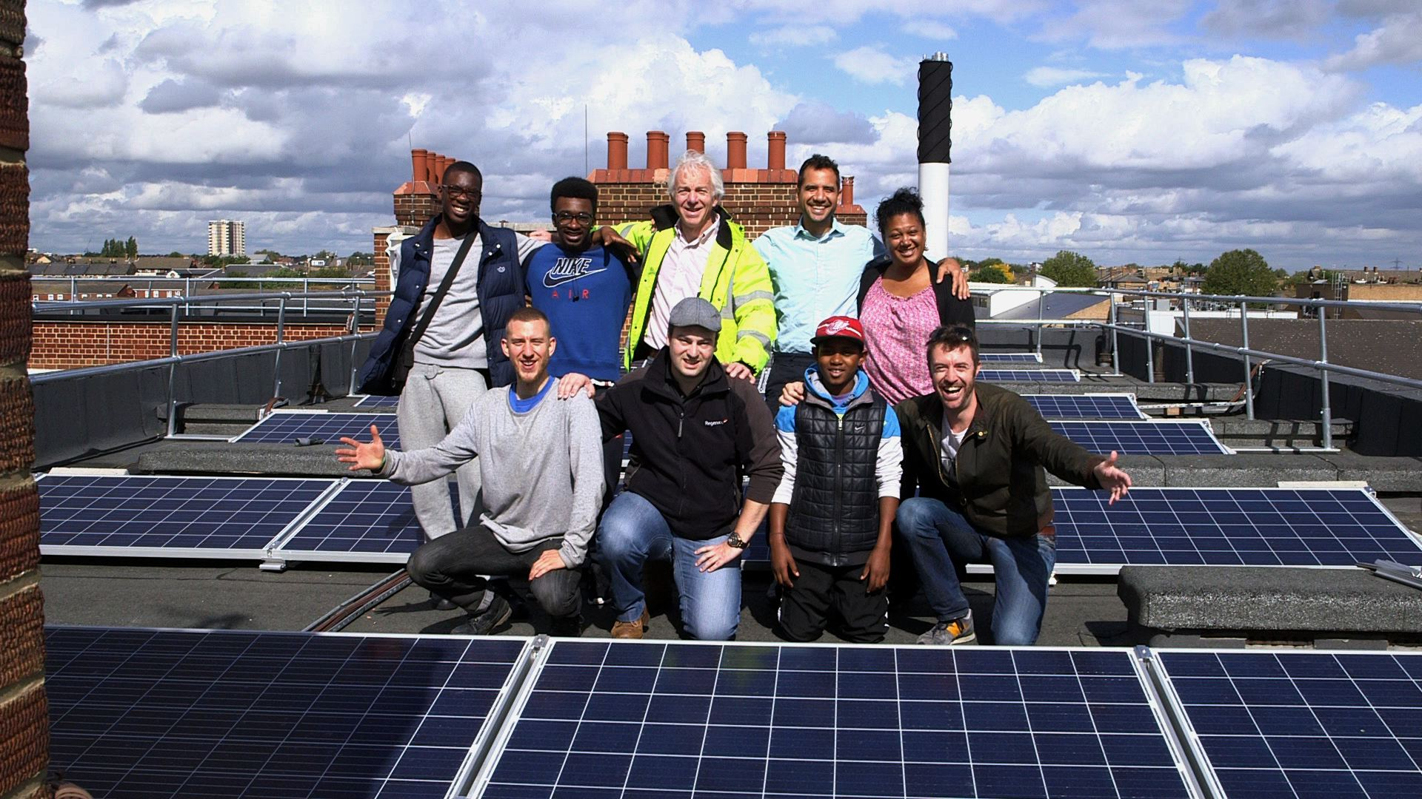
Project benefits
“Before I started this project, all I could think about was how to get off this estate, but last year, over many months of the project, I was delighted to see my two older children and some of their friends become part of Repowering’s 30 week internship programme, where every week they were engaged in learning – and getting paid. As they learned, I learned too and participated in a variety of free workshops that ran on the estate, including draught busting and energy saving… This project is something I feel is a really worthy cause, that will benefit us as a community and provide further opportunities for our young people in the long run.” Leila Fortunato, Banister House Estate resident, Banister House Solar Director

Slide 14
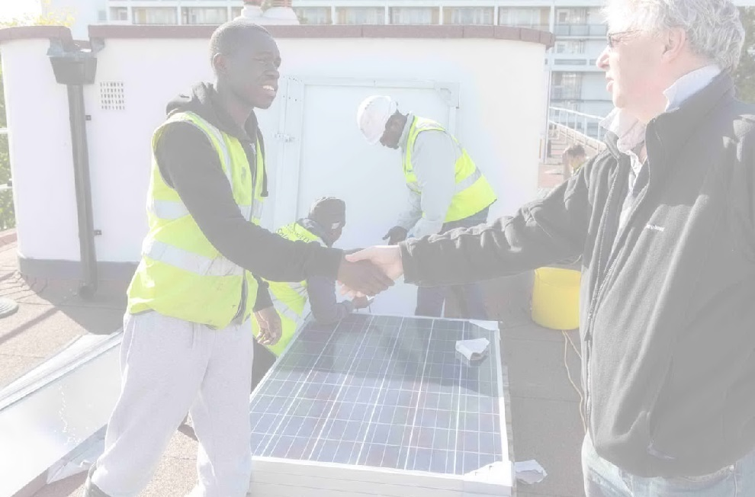
Thanks for your time
Afsheen Kabir Rashid
Co-founder & Director
+44 (0) 7834686264
Afsheen.Rashid@Repowering.org.uk
@RepowerLondon

