Slide 1

Leathermarket JMB & CBS:
Tenant control

Slide 2
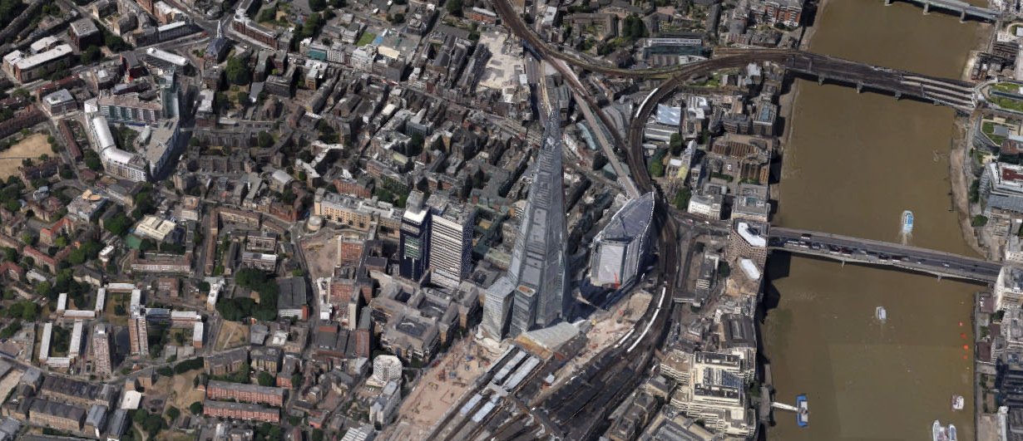
Tenant self- management

Slide 3
Quick stats
1053 tenants: 421 leaseholders (50% non-resident)
Southwark tenants & leaseholders: TMO manage
2016 continuation ballot- 94% support- 75% tenant turn-out & 66% overall turn-out
Southwark:15 TMOs- we are as big as the other 14 put together
2017 status survey: 92% recommend Southwark TMOs to family-85% for other Southwark tenants
74% TMO satisfaction, compared to 66% rest of Southwark

Slide 4
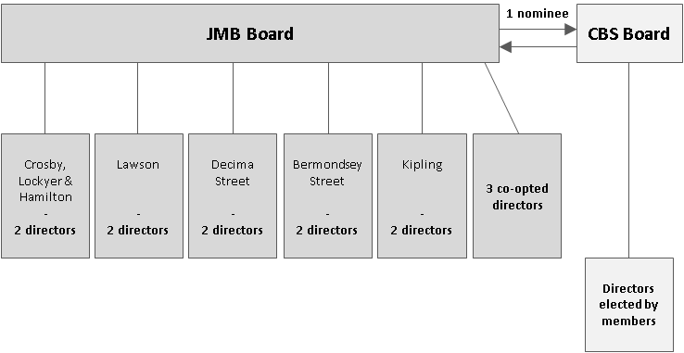
Tenants in control

Slide 5
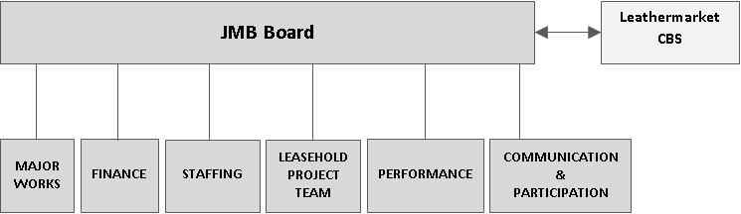
Tenants in control

Slide 6
Self-finance
Financing of council housing works
Keep income from rents and service charges
30 debt repayment on our homes
Pay for services will need Southwark to provide
Rest to pay for services & major works
30 year asset management plan: catching up on repairs backlog- 2016/17: 46% available expenditure spent on major works

Slide 7
Self-finance income

Slide 8
Self-finance expenditure

Slide 9
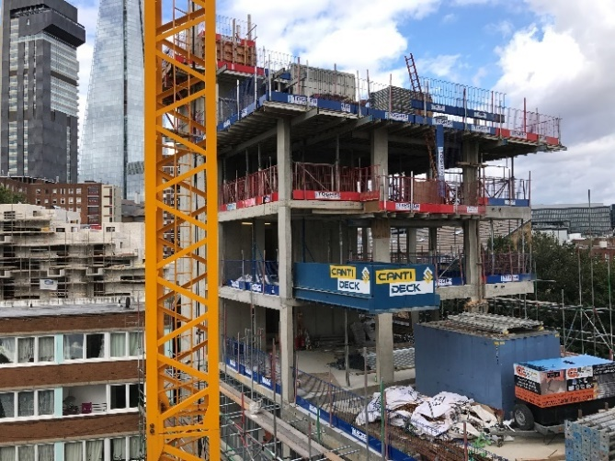
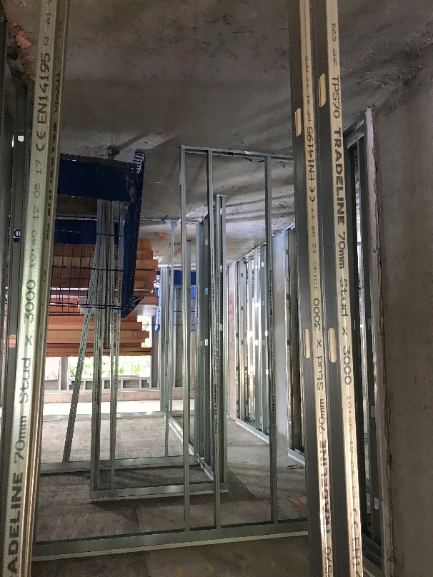
New Homes for council tenants at council rents
Leathermarket CBS
Marklake Court - 27 homes

Slide 10
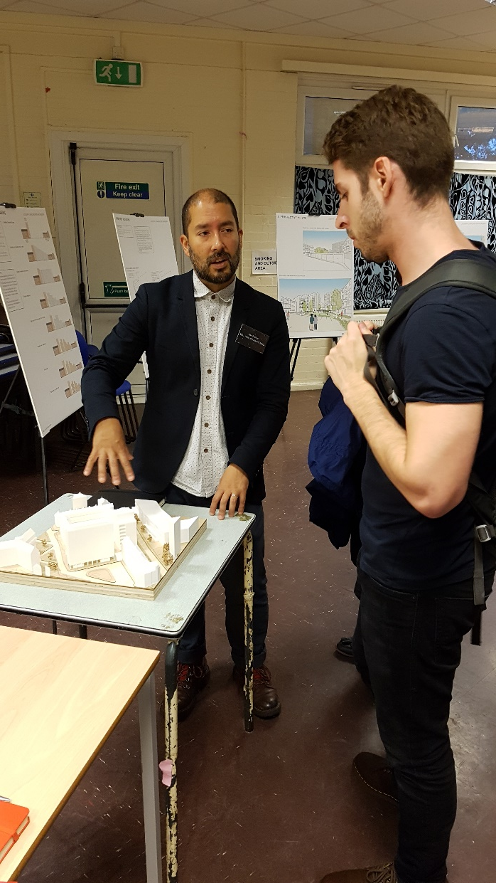
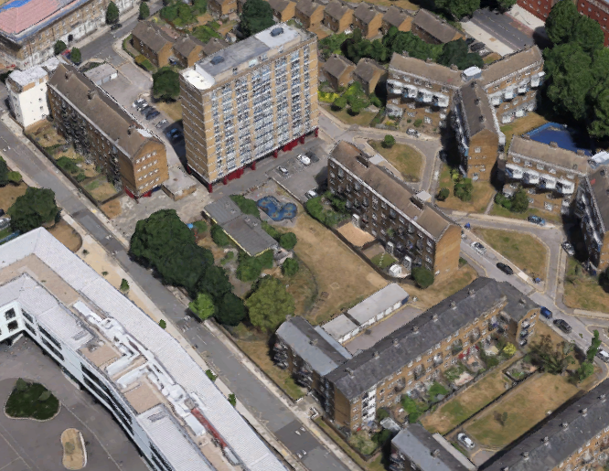
New Homes for council tenants at council rents
Leathermarket CBS
Joseph Lancaster nursery site - 40 homes

Slide 11
Finance
£300,000 loan from JMB (now £150,000)
GLA design& feasibility Marklake
Southwark Council construction Marklake
DCLG design & feasibility Joseph Lancaster
DCLG estates improvement plan
Southwark Council/ GLA/ DCLG construction costs
Future re-cycle rental income

Slide 12
Challenges
Housing & Planning Act (forced sales/ fixed-term tenancies)
Universal credit pilot: Ave tenant £70 in credit: 137 tenants on UC average arrears is £647
6% of residents don’t support us: 3% really don’t like us
Endemic problems in the construction industry (fight for quality)
High major works charges for some leaseholders, as we catch up on disrepair backlog

Slide 13

Communicate obsessively

